Slide 1
Baliram patil college kinwat ,nanded
Dept.Of Zoology
Topic: krebs cycle
Presented by: Pradip L.Rudraswad

Slide 2
Content:
Introduction
Krebs Cycle is a part of Cellular Respiration
Krebs Cycle Steps
Krebs Cycle Summary
Significance of Krebs Cycle

Slide 3
Introduction
The Krebs cycle or TCA cycle (tricarboxylic acid cycle) or Citric acid cycle is a series of enzyme catalysed reactions occurring in the mitochondrial matrix, where acetyl-CoA is oxidised to form carbon dioxide and coenzymes are reduced, which generate ATP in the electron transport chain.
Krebs cycle was named after Hans Krebs, who postulated the detailed cycle. He was awarded the Nobel prize in 1953 for his contribution.
It is a series of eight-step processes, where the acetyl group of acetyl-CoA is oxidised to form two molecules of CO2 and in the process, one ATP is produced. Reduced high energy compounds, NADH and FADH2 are also produced.
Two molecules of acetyl-CoA are produced from each glucose molecule so two turns of the Krebs cycle are required which yields four CO2, six NADH, two FADH2 and two ATPs.

Slide 4
Krebs Cycle is a part of Cellular Respiration
Cellular respiration is a catabolic reaction taking place in the cells
. It is a biochemical process by which nutrients are broken down to release energy, which gets stored in the form of ATP and waste products are released
. In aerobic respiration, oxygen is required.
Cellular respiration is a four-stage process. In the process, glucose is oxidised to carbon dioxide and oxygen is reduced to water.
The energy released in the process is stored in the form of ATPs. 36 to 38 ATPs are formed from each glucose molecule.

Slide 5
Steps of kreb cycle
It is an eight-step process. Krebs cycle or TCA cycle takes place in the matrix of mitochondria under aerobic condition.
Step 1: The first step is the condensation of acetyl CoA with 4-carbon compound oxaloacetate to form 6C citrate, coenzyme A is released. The reaction is catalysed by citrate synthase.
Step 2: Citrate is converted to its isomer, isocitrate. The enzyme aconitase catalyses this reaction.

Slide 6
Step 3: Isocitrate undergoes dehydrogenation and decarboxylation to form 5C 𝝰-ketoglutarate.
A molecular form of CO2 is released. Isocitrate dehydrogenase catalyses the reaction.
It is an NAD+ dependent enzyme. NAD+ is converted to NADH.
Step 4: 𝝰-ketoglutarate undergoes oxidative decarboxylation to form succinyl CoA, a 4C compound.
The reaction is catalyzed by the 𝝰-ketoglutarate dehydrogenase enzyme complex.
One molecule of CO2 is released and NAD+ is converted to NADH.

Slide 7
Step 5: Succinyl CoA forms succinate. The enzyme succinyl CoA synthetase catalyses the reaction. This is coupled with substrate-level phosphorylation of GDP to get GTP. GTP transfers its phosphate to ADP forming ATP.
Step 6: Succinate is oxidised by the enzyme succinate dehydrogenase to fumarate. In the process, FAD is converted to FADH2.
Step 7: Fumarate gets converted to malate by the addition of one H2O.
The enzyme catalysing this reaction is fumarase.
Step 8: Malate is dehydrogenated to form oxaloacetate, which combines with another molecule of acetyl CoA and starts the new cycle.
Hydrogens removed, get transferred to NAD+ forming NADH. Malate dehydrogenase catalyses the

Slide 8
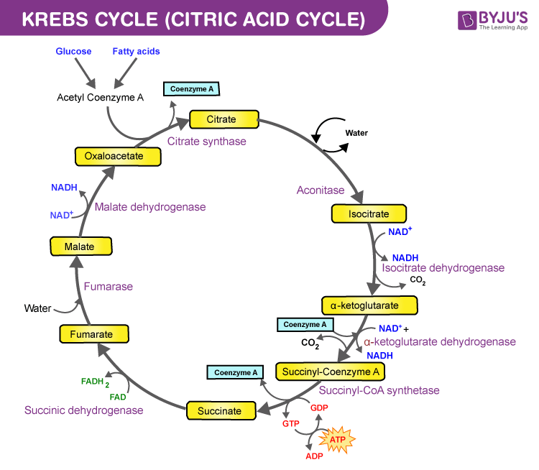

Slide 9
Krebs Cycle Summary
Location: Krebs cycle occurs in the mitochondrial matrix
Krebs cycle reactants: Acetyl CoA, which is produced from the end product of glycolysis
, i.e. pyruvate and it condenses with 4 carbon oxaloacetate, which is generated back in the Krebs cycle

Slide 10
Krebs cycle products
Each citric acid cycle forms the following products:
2 molecules of CO2 are released.
Removal of CO2 or decarboxylation of citric acid takes place at two places:
In the conversion of isocitrate (6C) to 𝝰-ketoglutarate (5C)
In the conversion of 𝝰-ketoglutarate (5C) to succinyl CoA (4C)
1 ATP is produced in the conversion of succinyl CoA to succinate
3 NAD+ are reduced to NADH and 1 FAD+ is converted to FADH2 in the following reactions:
Isocitrate to 𝝰-ketoglutarate → NADH
𝝰-ketoglutarate to succinyl CoA → NADH
Succinate to fumarate → FADH2
Malate to Oxaloacetate → NADH

Slide 11
Significance of Krebs Cycle
Krebs cycle or Citric acid cycle is the final pathway of oxidation of glucose, fats and amino acids
Many animals are dependent on nutrients other than glucose as an energy source
Amino acids (metabolic product of proteins) are deaminated and get converted to pyruvate and other intermediates of the Krebs cycle. They enter the cycle and get metabolised e.g. alanine is converted to pyruvate, glutamate to 𝝰-ketoglutarate, aspartate to oxaloacetate on deamination
Fatty acids undergo 𝞫-oxidation to form acetyl CoA, which enters the Krebs cycle
It is the major source of ATP production in the cells. A large amount of energy is produced after complete oxidation of nutrients
It plays an important role in gluconeogenesis and lipogenesis and interconversion of amino acids
Many intermediate compounds are used in the synthesis of amino acids, nucleotides, cytochromes and chlorophylls, etc.

