Slide 1
Baliram patil college kinwat, nanded
Dept.Of Zoology
Topic:Enzymes: Meaning, Mechanism, Classification, Factors,
Presented by:Pradip L.Rudraswad

Slide 2
Content:
: 1. Meaning of Enzymes
2. Classification of Enzymes
3. Mechanism of Enzyme Action
4. Factors Affecting

Slide 3
Meaning of Enzyme:
Enzymes are proteinaceous (and even nucleic acids) biocatalyst which alter (generally enhance) the rate of a reaction.
Free energy of activation and effect of catalysis:
A chemical reaction like substrate to product, will take place when a certain number of substrate molecules at any instant, possess enough energy to attain an activated condition called the “transition state” in which the probability of making or breaking a chemical bond to form the product is very high.
“Free energy of activation” is the amount of energy required to bring all the molecules in one gram mole of a substrate at a given temperature to the transition state.

Slide 4
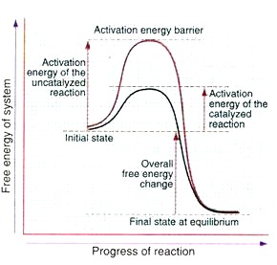

Slide 5
In presence of a catalyst, the substrate combines with it to produce a transient state having a lower energy of activation than that of the substrate alone.
This accelerates the reaction. Once the product is formed, the enzyme (catalyst) is free to combine with another molecule of the substrate and repeat the process.
Though there is a change in the free energy of activation in presence of an enzyme, the overall free energy change of the reaction remains the same whether the reaction is catalysed by an enzyme or not.

Slide 6
Classification of Enzymes:
Enzymes are broadly divided into six groups based on the type of reaction catalysed.
They are:
(1) Oxidoreductases
(2) Transferases
3) Hydrolases
(4) Lyases
(5) Isomerases and
(6) Ligases.

Slide 7
(a) Oxidoreductases:
Enzymes which bring about oxidation and reduction reactions.
Ex. Pyruvate + NADH—lactate dehydrogenase → Lactate + NAD +
Glutamic acid + NAD—glutamate dehydrogenase → α-ketoglutarate + NH3 + NADH

Slide 8
(b) Transferases:
Enzymes which catalyze transfer of groups from one substrate to another, other than hydrogen.
Ex. Transaminase catalyses transfer of amino group from amino acid to a keto acid to form a new keto acid and a new amino acid.
Ex. (α-Ketoglutarate + Alanine—alanine aminotransferase → Glutamate + Pyruvate
Aspartate + α-Ketoglutarate —aspartate aminotransferase Oxaloacetate + Glutamate

Slide 9
(c) Hydrolases:
Those enzymes which catalyse the breakage of bonds with addition of water (hydrolysis). All the digestive enzymes are hydrolases. Ex. Pepsin, trypsin, amylase, maltase.
(d) Lyases:
Those enzymes which catalyse the breakage of a compound into two substances by mechanism other than addition of water. The resulting product always has a double bond.
Ex. Fructose-1-6-diphosphate—ALDOLASE → Glyceraldehyde-3-phosphate + DHAP
(e) Isomerases:
Those enzymes which catalyse the inter-conversion of optical and geometric isomers.
Ex. Glyceraldehyde-3-phosphate—ISOMERASE → Dihydroxyacetone phosphate

Slide 10
(f) Ligases:
These enzymes catalyse union of two compounds. This is always an energy requiring process (active process).
Ex. Pyruvate + CO2 + ATP—pyruvate carboxylase Oxaloacetate + ADP + Pi

Slide 11
Factors Affecting Enzyme Action:
The factors influencing the rate of the enzyme catalysed reaction are:
1. Temperature
2. pH
3. Substrate concentration
4. Enzyme concentratio

Slide 12
1. Effect of Temperature:
When all the other parameters are kept constant (i.e. at their optimum level), then the rate of enzyme reaction increases slowly with increase of temperature till it reaches a maximum.
Further increase in temperature denatures the protein resulting in decrease in the enzyme action and a further increase in temperature may totally destroy the protein.
Optimum temperature:The temperature, at which the enzyme activity is maximum, is termed as the optimum temperature.
Most of the enzymes are totally inactive at 0° C to 4° C, their activity starts at 10° C and slowly increases reaching its maximum capacity at its optimum temperature.

Slide 13
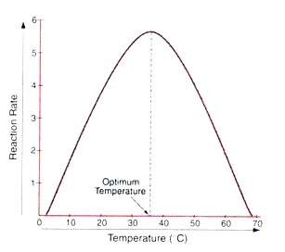
Majority of the enzymes in the human body have their optimum temperatures between 37° C and 40° C.
Beyond this temperature the enzymes become less active and may loose their activity completely at higher temperatures.

Slide 14
2. Effect of pH:
When all the other parameters are kept constant, the velocity of an enzyme catalysed reaction increases till it reaches the optimum pH and then decreases with further increase/decrease in pH.
The activity is maximum for most of the enzymes at the biological pH of 7.4. Optimum pH for pepsin is 1.5, acid phosphatase is 4.5 and for alkaline phosphatase it is 9.8

Slide 15
3. Effect of Substrate Concentration:
When all the other parameters are kept constant including the enzyme concentration, then, as the substrate concentration increases the rate of reaction increases steadily, till the enzyme is saturated with the substrate. At this stage the reaction rate does not increase and remains constant.
When a graph is plotted with velocity versus substrate concentration it gives a hyperbolic curve.

Slide 16
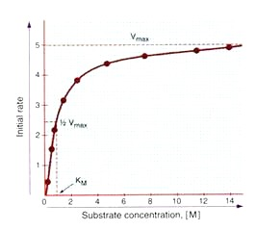
This is because, as the concentration of substrate is increased, the substrate molecules combine with all available enzyme molecules at their active sites till no more active sites are available.
Thus at this stage, substrate only replenishes the sites when the products are liberated and cannot increase the rate of reaction.

Slide 17
4.Enzyme concentration
As the enzyme concentration increases, the rate of reaction increases steadily in presence of an excess amount of substrate, the other factors being kept constant.
A linear curve is produced.

