Slide 1
Baliram patil college kinwat, nanded
Dept.Of Zoology
Topic: carbohydrates.
Presented by:Pradip L.Rudraswad

Slide 2
Content:
Meaning of carbohydrates
Classification of carbohydrates
Structure of carbohydrates
Function of carbohydrates

Slide 3
Meaning of Carbohydrates
Carbohydrates are a group of organic compounds consisting of C, H, O usually in the ratio of 1: 2: 1 and include such well known compounds as sugars, starch, cellulose etc.
Previously, the carbohydrates were regarded as hydrates of carbon and corresponded to general formula (C.H2O) n.
But the group name ‘carbohydrates’ was sometimes found mislead­ing because:
(i) Some organic compounds e.g., formaldehyde (HCHO), acetic acid (CH3COOH), lactic acid (C3H6O1) inositol (C6H12O6) etc. correspond to the general formula but are not carbohydrates

Slide 4
(ii) Some carbohydrates e.g., rhamnose (C6H12O5), rhamnohexose (C7H14O6), digitoxose (C6H12O4) do not correspond to the above general formula.
(iii) Besides containing C, H and O, some carbohydrates also contain nitrogen and sul­phur.
Therefore, the carbohydrates are more appropriately referred to as polyhydroxyaldehydes or polyhydroxyketones and their derivatives or the substances which yield these on hydroly­sis. But, the group name ‘carbohydrates’ is still retained traditionally.

Slide 5
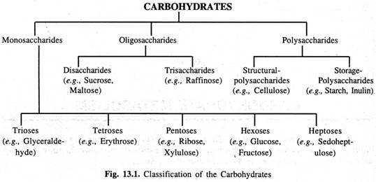
Classification
Depending upon their complexity and behaviour on hydrolysis, the carbohydrates are clas­sified into following 3 categories (Fig. 13.1).

Slide 6
1. Monosaccharides:
i. These are simplest of carbohydrates and are known as sugars.
ii. These are the building units of complex carbohydrates.
iii. These cannot be hydrolysed.
iv. These are sweet-tasting, crystalline and soluble in water.
v. They have a potential aldehyde or keto group and hence, are reducing in nature.
vi. Aldehyde group or the reducing centre always lies at C No. 1 of the monosaccharide molecule. Such sugars are known as aldoses or aldose sugars.
vii. Monosaccharide’s having keto groups at C No. 2.

Slide 7
Depending upon the number of the C atoms, the monosaccharide’s are further classified as follows:
(i) Triose Sugars, C3H6O3 (e.g., glyceraldehyde, dihydroxyaeetone)
(ii) Tetrose Sugars, C4H8O4 (e.g., erythrose)
(iii) Pentose Sugars, C5H10O5 (e.g., ribose, ribulose, xylose, xylulose, arabinose).
(iv) Hexose Sugars, C6H12O6 (e.g., glucose, fructose, galactose mannose).
(v) Heptose Sugars, C7H14O7 (e.g., sedoheptulose).

Slide 8
2. Oligosaccharides:
i. These consist of more than one but fewer number of monosaccharide molecules joined together by glycosidic bonds.
ii. On hydrolysis, they yield the monosaccharide units which may be similar or dissimilar.
iii. These are also sweet tasting, crystalline, soluble sugars
iv. These may or may not have a free -OH group at the reducing centre and accordingly may or may not be reducing

Slide 9
Depending upon the number of the monosaccharide molecules
(i) Disaccharides. C12H22O11 (e.g., sucrose, maltose, lactose etc.)
(ii) Trisaccharides, C18H32O16 (e.g., raffinose, gentianose etc.)

Slide 10
3. Polysaccharides:
i. These consist of a large number of (often thousands) monosaccharide units to form branched or un-branched chains.
ii. These can be hydrolysed to yield monosaccharide units which are usually similar.
iii. These are usually amorphous, tasteless, non-sugars and insoluble in water.
Polysaccharides can be grouped into two categories:
(i) Structural Polysaccharides (e.g., cellulose, hemi-cellulose, pectic substances, chitin, gum, mucilage(etc.)
(ii) Storage Polysaccharides (e.g., starch, inulin, glycogen etc)

Slide 11
Structural Features:
Monosaccharides:
Many monosaccharide’s e.g ribose, glucose, fructose etc. exist both in open straight chain and ring form.
If the ring is 5-membered it is called as furanose sugar. Sugar with a 6-membered ring is called as pyranose sugar e.g.,

Slide 12
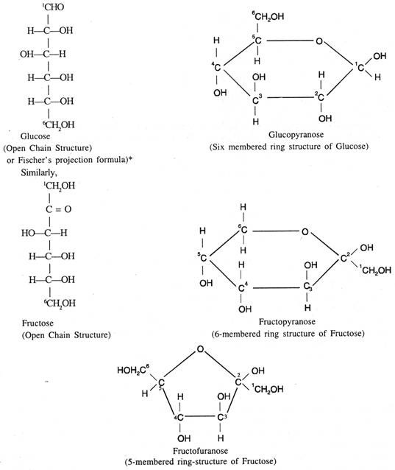

Slide 13
2. Disaccharides str.
Disaccharides consist of two sugar units. When subjected to a dehydration reaction (condensation reaction or dehydration synthesis), they release two monosaccharide units.
In this process, the hydroxyl group of one monosaccharide combines with the hydrogen of another monosaccharide through a covalent bond, releasing a molecule of water. The covalent bond formed between the two sugar molecules is known as a glycosidic bond.
The glycosidic bond or glycosidic linkage can be alpha or beta type. The alpha bond is formed when the OH group on the carbon-1 of the first glucose is below the ring plane, and a beta bond is formed when the OH group on the carbon-1 is above the ring plane.

Slide 14
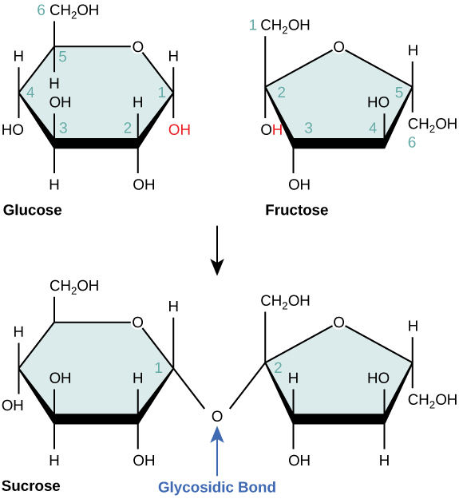

Slide 15
3. Oligosaccharides
Oligosaccharides are compounds that yield 3 to 10 molecules of the same or different monosaccharides on hydrolysis.
All the monosaccharides are joined through glycosidic linkage.
And based on the number of monosaccharides attached, the oligosaccharides are classified as trisaccharides, tetrasaccharides, pentasaccharides, and so on
The general formula of trisaccharides is Cn(H2O)n-2, and that of tetrasaccharides is Cn(H2O)n-3, and so on. The oligosaccharides are normally present as glycans
. They are linked to either lipids or amino acid side chains in proteins by N- or O-glycosidic bonds known as glycolipids or glycoproteins.

Slide 16
4. Polysaccharides str.
Homopolysaccharides:
They are composed of repeating units of only one type of monomer. A few examples of homopolysaccharides include cellulose, chitin, starches (amylose and amylopectin), glycogen, and xylans.
And based on their functional roles, these compounds are classified into structural polysaccharides and storage polysaccharides.
Cellulose is a linear, unbranched polymer of glucose units joined by beta 1-4 linkages. It’s one of the most abundant organic compounds in the biosphere.

Slide 17
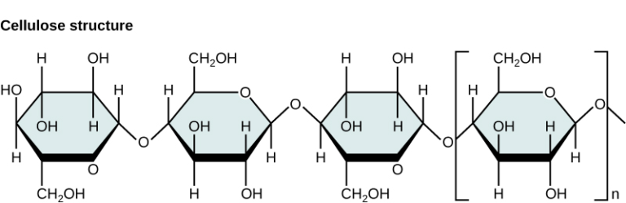
Homopolysacchrides

Slide 18
Heteropolysaccharides
They are composed of two or more repeating units of different types of monomers. Examples include glycosaminoglycans, agarose, and peptidoglycans. In natural systems, they are linked to proteins, lipids, and peptides.
Glycosaminoglycans (GAG) are negatively charged unbranched heteropolysaccharides. They are composed of repeating units of disaccharides with the general structural formula n.
Amino acids like N-acetylglucosamine or N-acetylgalactosamine and uronic acid (like glucuronic acid) are normally present in the GAG structure.

Slide 19
Function
Functions of Monosaccharides
Glucose (C6H12O6) is an important source of energy in humans and plants. Plants synthesize glucose using carbon dioxide and water, which in turn is used for their energy requirements.
They store the excess glucose as starch which humans and herbivores consume.
The presence of galactose is in milk sugar (lactose), and fructose in fruits and honey makes these foods sweet.
Ribose is a structural element of nucleic acids and some coenzymes.
Mannose is a constituent of mucoproteins and glycoproteins required for the proper functioning of the body

Slide 20
Functions of Disaccharides
Sucrose is a product of photosynthesis, which functions as a major source of carbon and energy in plants.
Lactose is a major source of energy in animals.
Maltose is an important intermediate in starch and glycogen digestion.
Trehalose is an essential energy source for insects.
Cellobiose is essential in carbohydrate metabolism.
Gentiobiose is a constituent of plant glycosides and some polysaccharides.

Slide 21
Functions of Oligosaccharides
Glycoproteins are carbohydrates attached to proteins involved in critical functions such as antigenicity, solubility, and resistance to proteases. Glycoproteins are relevant as cell-surface receptors, cell-adhesion molecules, immunoglobulins, and tumor antigens.
Glycolipids are carbohydrates attached to lipids that are important for cell recognition and modulate membrane proteins that act as receptors.
Cells produce specific carbohydrate-binding proteins known as lectins, which mediate cell adhesion with oligosaccharides.
Oligosaccharides are a component of fiber from plant tissues.

Slide 22
Functions of Polysaccharides
Structural polysaccharide:They provide mechanical stability to cells, organs, and organisms. Examples include chitin and cellulose.
Chitin is involved in the synthesis of fungal cell walls, while cellulose is an important constituent of diet for ruminants.
Storage polysaccharides: They are carbohydrate storage reserves that release sugar monomers when required by the body. Examples include starch, glycogen, and inulin. Starch stores energy for plants, and in animals, it is catalyzed by the enzyme amylase (found in saliva) to fulfill the energy requirement.
Glycogen is a polysaccharide food reserve of animals, bacteria, and fungi, while inulin is a storage reserve in plants.
Agarose provides a supporting structure in the cell wall of marine algae.
Peptidoglycan is an essential component of bacterial cell walls.
It provides strength to the cell wall and participates in binary fission during bacterial reproduction.

