Slide 1
External morphology of rat
The body can be divided into head, short neck and trunk (Fig. 1.131). The whole body of Rattus Norvegicus is covered by gray hairs. The head is pro­duced anteriorly into a blunt shout, which ends into a terminal mouth.
The upper lip has a vertical slit. The incisor teeth always remain exposed through this slit.
External nares are present just above the mouth near the tip of the snout.
Eyes are situated on the sides of the head.
The eyes possess movable upper and lower well developed eyelids. The nictitating membrane is supported by a semilunar cartilage and lies in the medial corner of each eye.
The eye lashes are very fine and short.

Slide 2
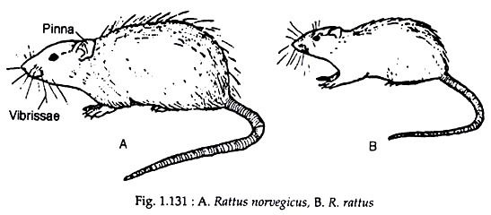
On the top of the head is a pair of short, rounded and movable external ears, the conch or pinna which is cartilage- nous. In certain regions of the head, thick, long, tactile sensory hairs, called vibrissae, are present (Fig. 1.131).

Slide 3
Head is joined to the trunk by a distinct neck. It permits free movement of the head in all directions.
Trunk is divided into thorax and abdo­men. The ventral surface of the females bears twelve nipple teats. Three pairs of which are in the thoracic region and are called pectoral teats, the other three pairs are abdominal in position and are called inguinal teats.
On the posterior part of the ventral abdomen, three external openings are present—anus, vagina and urethra.
In the male, the testes descend during the breeding season into the thin-walled scrotal sac from the posterior abdominal region
. Near the anterior end of the scrotum is the penis, containing the urinogenital opening.
It is enclosed in a loose sheath, the prepuce. yover­lapping scales.
From beneath each scale, three hairs and short bristles emerges out.

Slide 4
Circulatory system:Rat
Blood: Blood consists of liquid plasma and many corpuscles floating in the plasma.
The plasma is a pale yellow fluid and con­tains various inorganic salts, vitamins and hormones.
There are three different types of blood corpuscles. They are erythrocytes, leu­cocytes and thrombocytes
Erythrocytes or red blood corpuscles or RBC are round and biconcave.
Mature erythrocytes are non-nucleated and contain a red pigment called haemoglobin.
Haemoglobin renders red colour to the blood.
It has a strong but loose affinity for oxygen.

Slide 5
The red blood corpuscles carry oxygen to different parts of the body and carry back carbon dioxide from different parts of the body to the lungs through the heart.
Leucocytes or white blood corpuscles or WBC are larger than RBC and their num­ber is much less than RBC.
The leucocytes are of different types and their classification is dependent upon the structure of nucleus and stain-ability of the cytoplasmic granules.
These cells move in amoeboid fashion and act as scavengers of the body.
These cells move in amoeboid fashion and act as scavengers of the body. Thrombocytes or blood platelets are small and non-nucleated.
They occur in groups. In case of injury these cells break down and produce an enzyme which coagulates the blood and thereby prevents loss of blood.

Slide 7
(ii) Heart:
The heart is located in a space within the thorax between the two pleural bags.
The space is known as mediastinum. The heart is covered over by a thin peritoneal membrane called pericardium.
Pericardium is two layered.
The outer layer is known as fibrous pericardium and the inner layer is called serous pericardium.
The serous peri­cardium, in reality, is again made up of two layers. The innermost layer adherent to heart is called visceral layer or epicardium and the other (outer) one is called parietal layer.
The space between the fibrous layer and serous layer is known as pericardial cavity

Slide 8
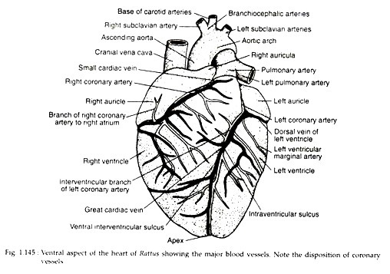
The heart is a muscular, internally hollow, four-chambered and cone-shaped structure that occupies most of the thoracic cavity.
It lies roughly in the midline of the cavity with its base located cranially and the apex caudally

Slide 9
The heart is four-chambered consisting of two auricles (left and right) and two ven­tricles (left and right).
The right auricle lies cranial to right ventricle and receives the venous systemic blood.
An internally located ridge within the right auricle divides it into two regions— sinus venarum cavarnum and right auricula.
The sinus venarum cavarnum is smooth- walled but the auricula is lined by five mus­cular ridges called pectinate muscles. There are four main openings in the right auricle.
Blood enters in the right auricle through three of these openings while through the other, blood passes on to the right ventricle.

Slide 10
Content:
External morphology of rat
Circulatory system of Rat

Slide 11
Baliram patil college kinwat, nanded
Dept. Of Zoology
Topic: Rat- external morphology and circulatory system
Presented by:Pradip L.Rudraswad

