Slide 1
Content:
1)Non-poisonous snake
2) Poisonous snake.....
3) Importance of the snake poison

Slide 2
Non-Poisonous Snakes:
Colour:Usually not brightly coloured, but pythons, common sand boa, red sand boa, anaconda, wart snakes (Acrochordus granulatus), etc. are brightly coloured.
Shape of head:Head is usually narrow and elongate inparticular shape
Neck:No constriction in the neck.usually not seen much
Hood:Hood is absent.
. Tail:Tail tapered and long except burrowing snakes. In Typhlopidae and Leptotyphlopidae the tail is short and stumpy. In Uropeltidae the tail is very short and rough. In sand boas also the tail is short and blunt.
Head scales:Scales on the top of the head are large but in sand boas(Eryx conicus) the head scales are small
Dorsal scales:Scales on the dorsal surface are longer but spinal (vertebral) scales are not longer and hexagonal.

Slide 3
8.Ventral scales:Ventral scales are either across the belly completely (e.g., Colubridae), or not completely across the belly (e.g., Boidae, Uropeltidae).
9. Loreal shield:Absent
10. Mental shield small
11. Caudal scales:Uniform and solid
12. Teeth:niform and solid
13. Poison gland:Absent
14. Muscular system:Well-developed strong muscular system.
15. Lungs:Both lungs are present.
16. Hypophysis:Hypophyses absent or present on the posterior dorsal vertebrae.
17. Streptostylis
18. Less marked.
Example:Rat Snake (Ptyas mucosus), Indian Python (Python molurus), Sand Boa (Eryx conicus), Checkered keel back [Natrix (Xenocrophis) piscator], Wolf Snake (Lycodon aulicus), Striped Keel back (Amphiesma stolata).

Slide 4
Poisonous Snakes:
Colour:Generally brightly coloured
Shape of head:Head is long, triangular and posteri­or portion is wide.
Neck:Neck always constricted.
. Hood:Present in majority cases; highly developed in Cobra group (Naja sp.); absent in Coral snakes, Krait, Russell’s viper, etc.
Tail:Tail is abruptly tapered, but in sea snakes (Hydrophidae) the tail is flat- tend to form an oar-shaped structure and in land snakes the tail is cylin­drical.
Head scales:Scales on the top of the head are usually small.
Dorsal scales:Dorsal surface scales are smaller but the spinal (vertebral) scales are lar­ger and hexagonal in kraitkra

Slide 5
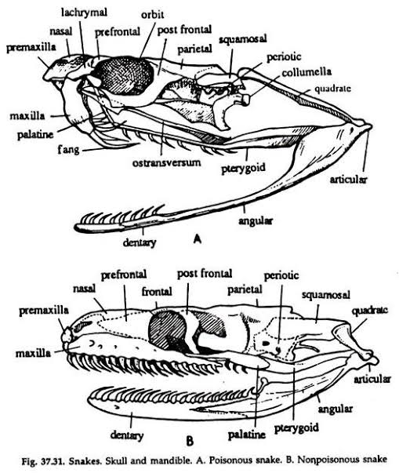

Slide 6
Ventral scales:Ventral scales are usually completely across the belly but in sea snakes ventral scales are not completely across the body.
Loreal shield:Present, shapes may be variable.
Mental shield:Fourth one is large.
Caudal scales:mostly undivided except coral and cobra snakes.
. Teeth:Most of the teeth are solid and uni­form except maxillary teeth which are large, and provided with groove or canal. These large teeth are called ‘Fangs’.
. Poison gland:Present. Paired poison glands are on upper jaw.

Slide 7
Importance of Snake Poison
Snake venoms are used for treatment of various diseases like epilepsy, asthma, arthri­tis, chronic nervous and muscular pain, neuri­tis, neuralgia, migraine and pain for cancer. Russell viper’s venom can be used as haemo­static agent.
To stop the internal bleeding venom’s dilution can be used. In homeopathy rattle snakes venom is used to cure various diseases like lumbago, sciatica, coccygodynia, laryngitis, pleurisy and insomia, etc.

Slide 8
Baliram Patil College kinwat,Nanded
Dept.Of Zoology
Topic: Poisonous and non poisonous snake
Presented by:Pradip L.Rudraswad

