Slide 1
Baliram patil college kinwat ,nanded
Dept.OF Zoology
Topic : scoliodon--external morphology and Digestive system
Presented by:Mr.Pradip L.Rudraswad

Slide 2
Content:
External Structures of Scoliodon (With Diagram) |
Digestive system of scoliodon

Slide 3
External morphology:scoliodon
Scoliodon is an elongated spindle-shaped animal.
It has a laterally compressed body. A fully developed specimen of this genus attains a length of about 60 cm.
Body is divi­sible into head, trunk and tail
. Head is dorsoventrally flattened and terminates ante­riorly into a dorsoventrally compressed snout.
The dorsal side of Scoliodon is dark-grey while the underside is pale white.
Tail is oval in cross-section and bears a heterocercal type of caudal fin, i.e., the posterior end of the vertebral column is bent upwards and lies in the dorsal or epichordal lobe.
Mouth is a very wide crescentic aperture lying on the ventral side of the head near its anterior end

Slide 4
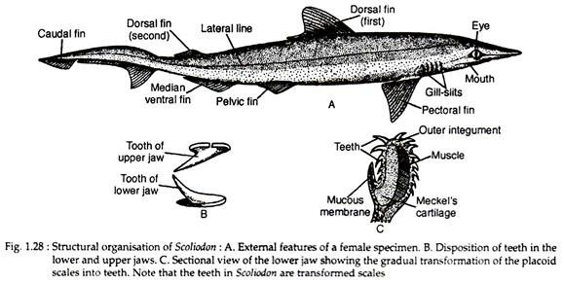
It is bounded by upper and lower jaws; each is beset with one or two rows of sharply pointed and backwardly directed teeth (Fig. 1.28B) to catch the slippery prey. The teeth are replaced if these are broken. The teeth of Scliodon are modified scales. The scales cover its body and extend inside the jaws to serve as teeth (Fig. 1.28C).

Slide 5
The transition of the pla­coid scales into teeth is amply recorded in the jaw regions.
Two prominent circular eyes are present.
Each eye is provided with movable upper and lower eyelids. The third eyelid or nicti­tating membrane can cover the whole eye in emergency.
The pupil is a vertical slit-like aperture. The nostrils are placed one at each angle of the mouth.
These are exclusively olfactory in function and have no connection with the mouth cavity.
Each nostril is partly covered by a small fold of skin. Posterior to the eyes there are five vertical slits on each side.
They are called gill or branchial slits.
The branchial slits lead into the gill pouches which in turn open into the pharyngeal cavity.

Slide 6
Digestive system
The digestive system of scoliodon consists of the alimentary canal and the digestive glands.
The alimentary canal starts with the mouth and terminates in the anus.
The mouth leads into a spacious buccal cavity which is lined with mucous mem­brane.
The floor of the buccal cavity becomes folded to form a non-muscular and non-glandular tongue
. The mucous membrane is very thick and rough due to the presence of dermal denticles or teeth.
The teeth are very sharp and are obliquely placed
. The teeth are homodont (i.e., the teeth are similar in shape) and possesses several sets of teeth functio­ning in succession

Slide 7
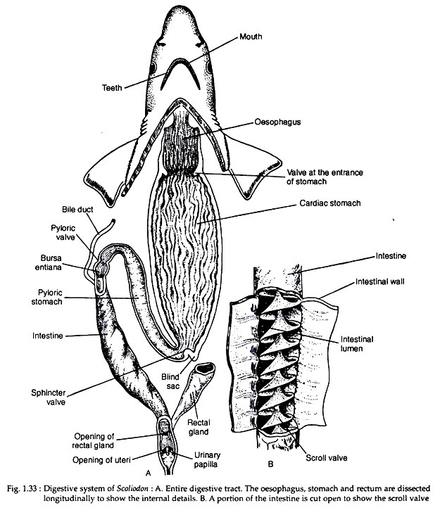

Slide 8
The oesophagus dilates posteriorly to form a large stomach
. The stomach is highly muscular and is bent on itself to form a J-shaped configuration.
The long limb of the stomach is continuous with the oesophagus and the shorter one passes into the intestine.
The entrance of the oesophagus into the stomach is provided with a crescentic fold which serves as the valve.
The long anterior limb is called the cardiac stomach and the short posterior limb is designated as the pyloric stomach.
A small outgrowth, often called ‘blind sac’, is present at the junction of the cardiac and pyloric limbs
. The inner lining of the cardiac stomach is folded longitudinally like that of oesophagus (Fig. 1.33A).

Slide 9
The internal lining of the pyloric stomach is mostly smooth though slight foldings are observed at the distal end
. The pyloric valve, at the end of the pylorus, guards the entrance of it into a thick-walled small chamber called the bursa entiana.
The bursa entiana is immediately followed by wide tubular intestine which becomes narrowed posteriorly as the rectum.
The rectum opens into the cloaca. A tubular caecal or rectal or digitiform gland opens into the rectum.
The inner surface of the intestine becomes folded to form an anticlockwise spiral of approximately two and a half turns.
This is called the scroll valve (Fig. 1.33B) which increases the absorptive surface of the intestine and also checks the rapid flow of digested food through the intestine

Slide 10
The major digestive gland is the liver which is a massive yellowish gland and consists of two lobes. The lobes are united anteriorly.
A thin-walled V-shaped gall­bladder is present in the anterior part of the right lobe of liver.
The bile duct receives few smaller ducts from the two lobes of the liver and opens into the anterior end of intestine, near the commencement of the scroll valve.
The pancreas is a pale compact irregular body and consists of a dorsal lobe situated parallel to the posterior part of cardiac stomach and a ventral lobe which remains closely attached to the pyloric stomach.
The pancreatic juice is poured into the intestine by pancreatic duct situated opposite to the aperture of the bile duct.

Slide 11
The functional significance of rectal gland is not properly known.
The rectal gland has a central cavity lined with cuboidal cells.
It is highly vascular and composed of lymphoid tissue. It discharges a fluid into the lumen of the intestine but its actual role is not known.
The buccal cavity possesses no such glands that can be compared with the sali­vary glands of higher vertebrates.
The spleen is located dorsal to the distal end of the body of the stomach.
The spleen is functionally associated with the circulatory system, but remains morphologically connected with the alimentary canal.

