Slide 1
Baliram patil college kinwat,nanded
Dept.of zoology
Presented by: mr.Pradip laxman Rudraswad

Slide 2
Content:
1)General characteristics and classification
2)structure and Life cycle of teaniaSolinum.

Slide 3
Genaral Charcterstics
Phylum Platyhelminthes are triploblastic, acoelomate (without a body cavity) and bilaterally symmetrical animals.
Body is soft, un-segmented and dorsoventrally flattened.
Metameric segmentation and skeletal structures, in any form, are absent. Pseudometamerism is seen in some mmembers
. Anterior end of the body is differenti­ated into a head.
Locomotion of Phylum Platyhelminthes is effected by the use of cilia rather than muscles.
The excretory system consists of protonephridia with flame cells or bulbs.

Slide 4
Reproductive system is generally her­maphroditic but the digenean flukes are gonochoristic (separate sexes),Fertilization internal.
At early Cleavage spiral, and determinate in some species Development may be direct or indirect
Flatworms are either mostly free-living (Turbellarians) or are internal or exter­nal parasites (Trematodes, cestodes and monogeneans).
Parthenogenesis and polyembryony usually occur in trematodes and tape­worms.

Slide 5
Classification:
Class 1. Turbellaria (Gk. turbella = a little string); Approx. 3000 species.
Mostly free-living, primarily aquatic and the great majority are marine and mostly benthic; a few are terrestrial, some are commensals for parasites.
Generally small, flattened, bilaterally symmetrical with a low level of cephalization
)Un-segmented body and. Cilia scattered on epidermi
Locomotion by cilia with muscular undulations
5) .Body surface of many species bears small, rod-like, hyaline rhabdites and related rhabdoids—unique in turbellarians and the function is uncertain.
Ex.Euplanaria, Bipalium and Geoplana (terrestrial triclads),

Slide 6
Class 2. Trematoda
All are parasites
Unsegmented, dorso-ventrally flattend body, hence trematodes are called “flukes
A syncytial, non-ciliated body cover­ing or tegument present.
Rhabdites absent in epidermis
One or more well developed suckers are present. Oral sucker for feeding and ventral sucker (acetabulum) for attachment.
Digestive tract complete with two branches.
Mostly hermaphrodites.No asexual reproduction
includes two subclasses—(i) Digenea (ii) Aspidobothria (= Aspidogastrea)
Ex.Aspidogaster, Stichocotyle, Cotylapsis

Slide 7
Class 3. Monogenea
Ectoparasites of aquatic vertebrates (on fishes and also on amphibians and reptiles
Dorsoventrally flattened body. Sucker is weak or absent.
Posterior end bears a large specialized adhesive disc, called haptor (= opisthaptor) which bears hooks and suckers, used for attachment. In addi­tion there is an anterior adhesive or­gan, called prohaptor, with adhesive glands and suckers.
Gut present but the mouth lacks a sucker.or­gan
Inconspicuous protonephridia include paired excretory pores situated anterodorsally.
Single host in the life cycle.. There is no intermediate host and the one egg gives rise to only one adult worm, hence the name “Monogenea”.
Ex.Gyrodactylus, Polystoma, Sphyranura, Dactylogyrus, Diplozoon

Slide 8
Class 4. Cestoidea
Gut parasites of the vertebrates
Generally called tape-worms.
Body covered by a non-ciliated syncy­tial tegument.
Body divided into 3 regions:
(i) Head or scolex usually with hooks and suckers for adhesion in the host’s gut,(ii) The proliferative neck and(iii) Strobila which consists of a large number of segments, called proglottids
Mouth, digestive tract and sense or­gans absent.
Examples. Gastrotaenia (found in swan), Nematoporataenia.

Slide 9
Life cycle :T.solinum
Majority of tapeworms are hermaphrodite. A hermaphrodite is an organism with both male and female reproductive organs. They produce gametes of both male and female sexes.
1)The Egg – Stage --Tapeworm eggs are usually released through gravid proglottids and can survive for days in the environment. Animals like cattle or pigs become infected by tapeworms when they consume vegetation.
2)The Larvae – Stage 2 –The larvae tapeworm attaches itself to the intestinal walls of the host. The hatched larvae migrate to the striated muscles of the intestine. Here, they develop into cysticerci. Cysticerci can survive inside the host for several years. Human beings get infected with this cysticerci by consuming raw or undercooked meat.

Slide 10
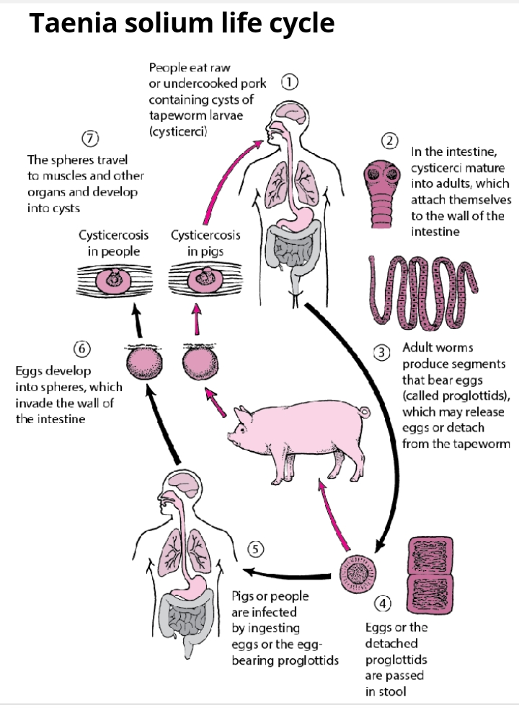

Slide 11
3) 3)The Adult – Stage 3 –inside the human intestine, the cysticerci develop for about 2 months and transform into an adult tapeworm. Scolex is the anterior end of a tapeworm that has suckers and hooks for attaching purposes. The adult tapeworm produces proglottids that mature, become gravid, eventually detach and migrate to the anus or pass in the stool.

