Slide 1

Fundamental of Computer
By
Asst.Prof Dr.Yogesh Somwanshi
Asst.Prof Yogesh Somwanshi Fundamental of Computer

Slide 2
Lecture No 1 Introduction (What, Why and Where Computer. . .)
Asst.Prof Yogesh Somwanshi Fundamental of Computer

Slide 3
Today Covered
In this lecture we will cover the following
What is Computer?
Block diagram of Computer.
Characteristics of Computer
Asst.Prof Yogesh Somwanshi Fundamental of Algorithm

Slide 4
What is A Computer?
The word computer comes from the word “compute”, which means, “to calculate”
Thereby, a computer is an electronic device that can perform arithmetic operations at high speed
A computer is also called a data processor because it can store, process, and retrieve data whenever desired
Definition: “Computer is an electronic device it takes input(Data) from users , process on it, and give the desire out put (Information)”
Asst.Prof Yogesh Somwanshi Fundamental of Computer

Slide 5

What is A Computer?
Asst.Prof Yogesh Somwanshi Fundamental of Computer

Slide 6
Characteristics of Computers
Automatic: Given a job, computer can work on it automatically without human interventions
Speed: Computer can perform data processing jobs very fast, usually measured in microseconds (10-6), nanoseconds (10-9), and picoseconds (10-12)
Accuracy: Accuracy of a computer is consistently high and the degree of its accuracy depends upon its design. Computer errors caused due to incorrect input data or unreliable programs are often referred to as Garbage- In-Garbage-Out (GIGO)
Diligence: Computer is free from monotony, tiredness, and lack of concentration. It can continuously work for hours without creating any error and without grumbling
Asst.Prof Yogesh Somwanshi Fundamental of Computer

Slide 7
Characteristics of Computers
Versatility: Computer is capable of performing almost any task, if the task can be reduced to a finite series of logical steps
Power of Remembering: Computer can store and recall any amount of information because of its secondary storage capability. It forgets or looses certain information only when it is asked to do so
No I.Q.: A computer does only what it is programmed to do. It cannot take its own decision in this regard
No Feelings: Computers are devoid of emotions. Their judgement is based on the instructions given to them in the form of Programs that are written by us (human beings)
Asst.Prof Yogesh Somwanshi Fundamental of Computer

Slide 8
What is A Computer?
Asst.Prof Yogesh Somwanshi Fundamental of Computer

Slide 9
Block diagram of Computer?
Asst.Prof Yogesh Somwanshi Fundamental of Computer

Slide 10
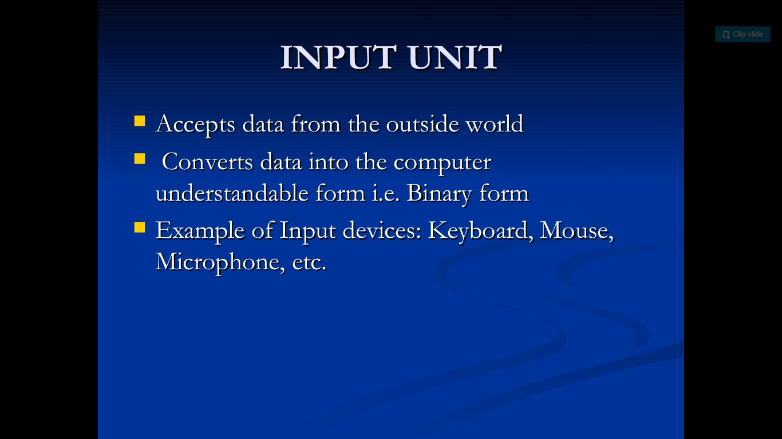
INPUT
Asst.Prof Yogesh Somwanshi Fundamental of Algorithm

Slide 11
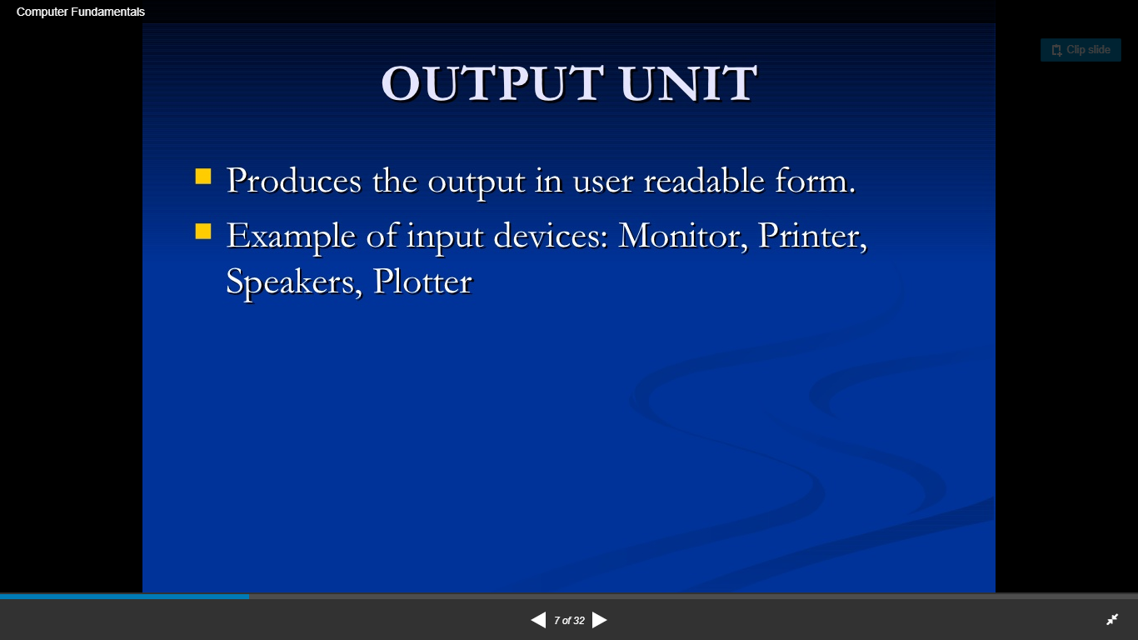
OUT PUT
Asst.Prof Yogesh Somwanshi Fundamental of Algorithm

Slide 12
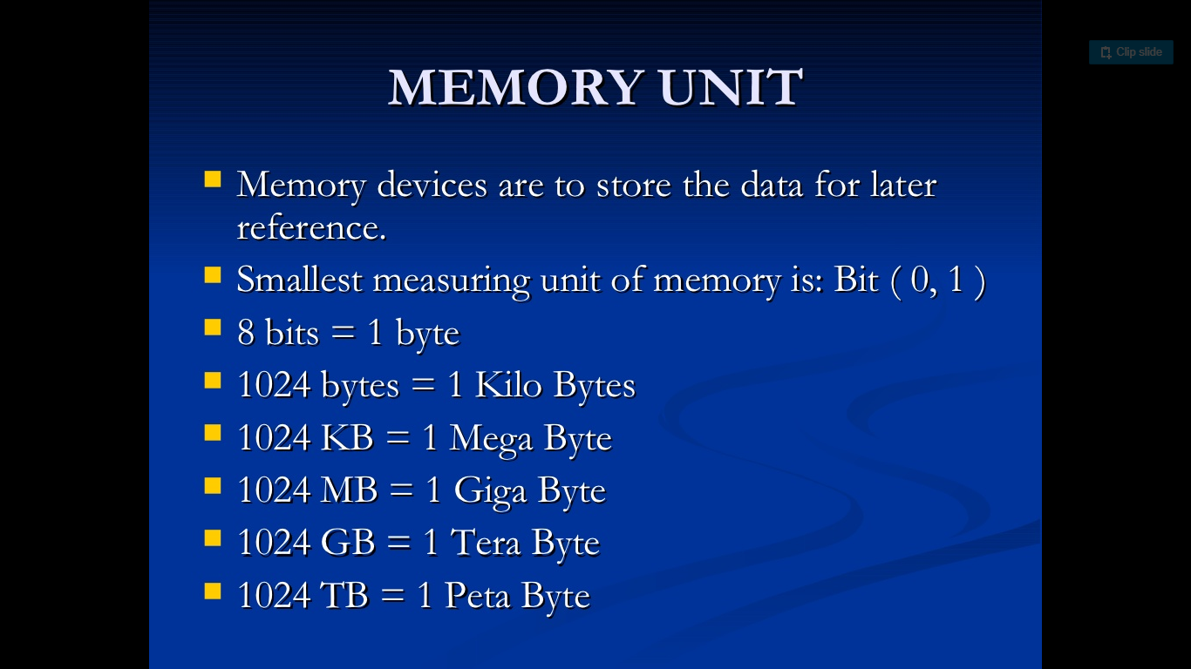
Computer Memory
Problem
The statement of the problem specifies, in general terms, the desired input/output relationship.
Algorithm
The algorithm describes a specific computational procedure for achieving input/output relationship.
Example
One might need to sort a sequence of numbers into non-decreasing order.
Algorithms
Various algorithms e.g. merge sort, quick sort, heap sorts etc.
Asst.Prof Yogesh Somwanshi Fundamental of Algorithm

Slide 13
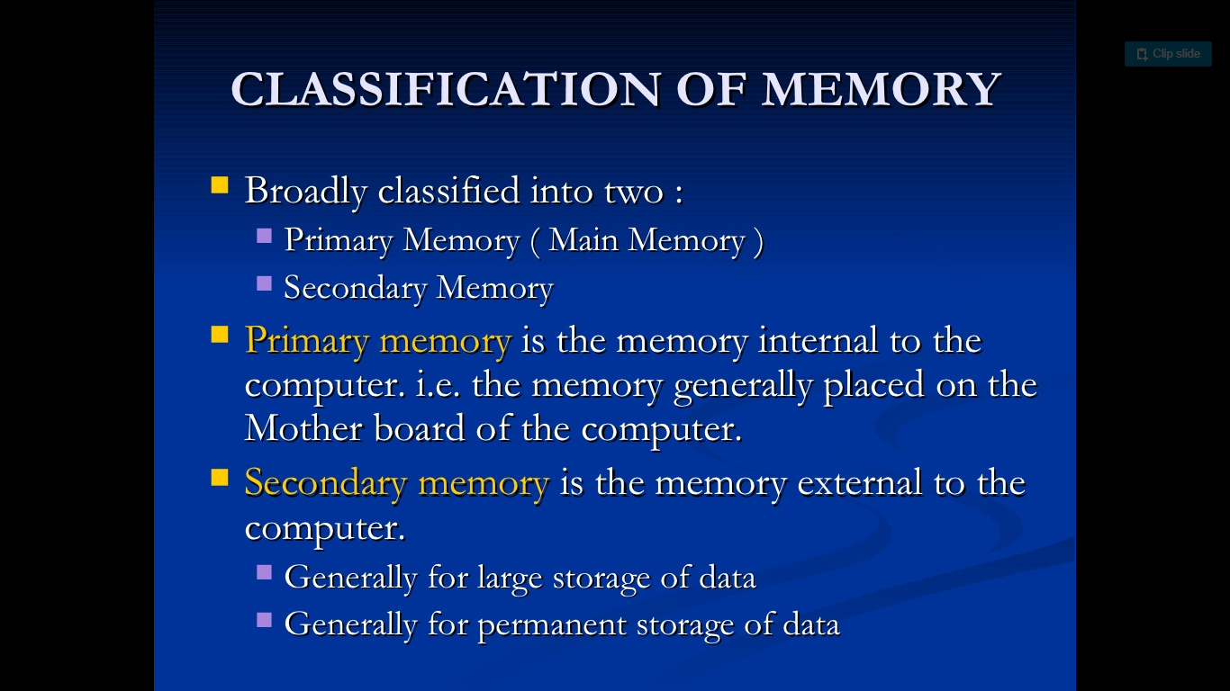
Types of Memory
Brute Force
Straightforward, naive approach
Mostly expensive
Divide-and-Conquer
Divide into smaller sub-problems
Iterative Improvement
Improve one change at a time
Decrease-and-Conquer
Decrease instance size
Transform-and-Conquer
Modify problem first and then solve it
Space and Time Tradeoffs
Use more space now to save time later
Asst.Prof Yogesh Somwanshi Fundamental of Algorithm

Slide 14
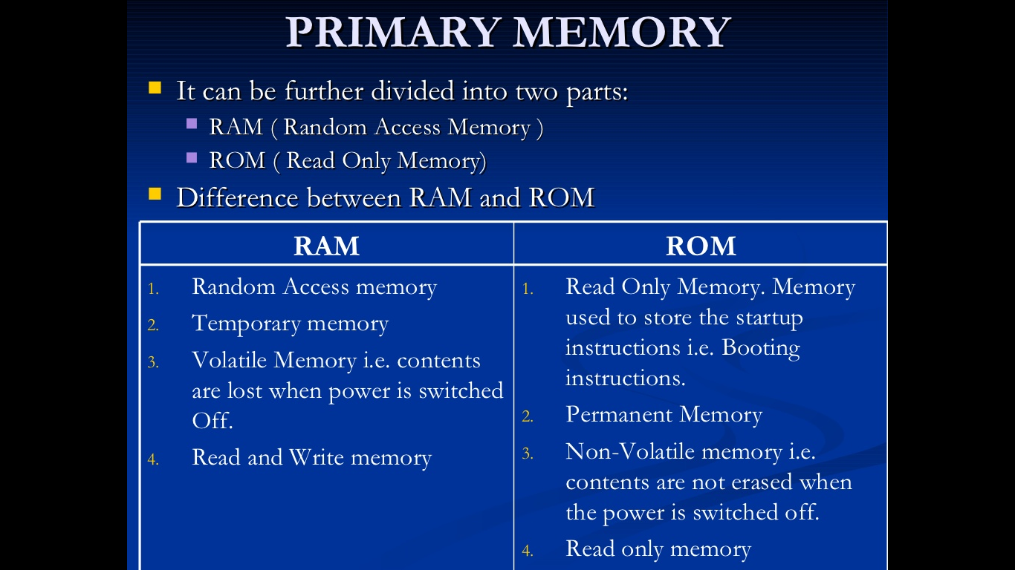
Volatile Memory( Temporary Memory)
Greedy Approach
Locally optimal decisions, can not change once made.
Efficient
Easy to implement
The solution is expected to be optimal
Every problem may not have greedy solution
Dynamic programming
Decompose into sub-problems like divide and conquer
Sub-problems are dependant
Record results of smaller sub-problems
Re-use it for further occurrence
Mostly reduces complexity exponential to polynomial
Asst.Prof Yogesh Somwanshi Fundamental of Algorithm

Slide 15
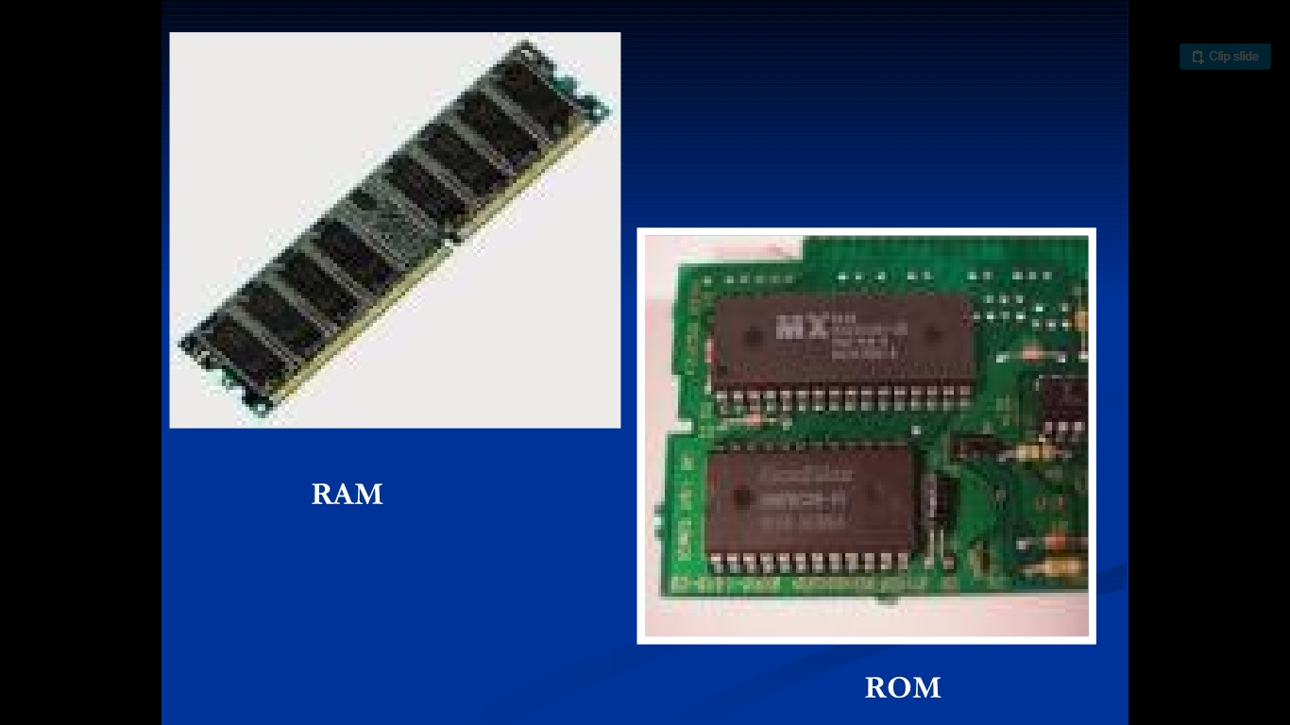
RAM/ROM
Analysis
How does system work?
Breaking a system down to known components
How components (processes) relate to each other
Breaking a process down to known functions
Synthesis
Building tools
Building functions with supporting tools
Composing functions to form a process
How components should be put together?
Final solution
Asst.Prof Yogesh Somwanshi Fundamental of Algorithm

Slide 16
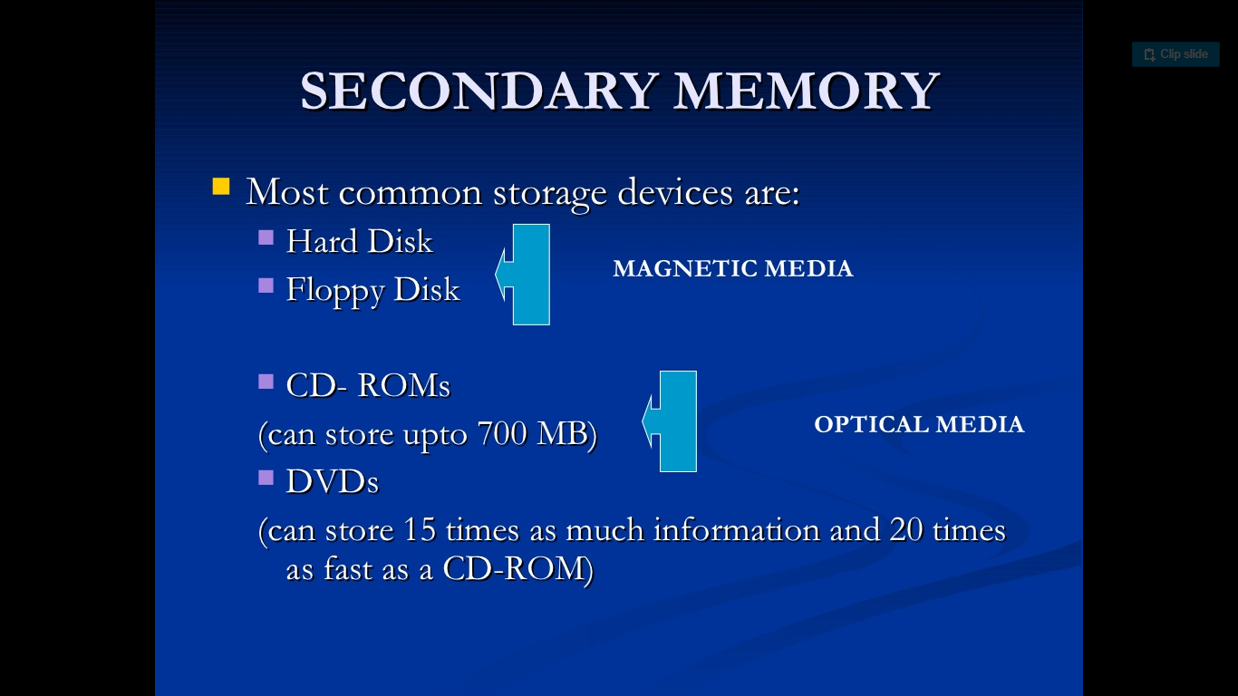
Permanent Memory
Problem
Strategy
Algorithm
Input
Output
Steps
Analysis
Correctness
Time & Space
Optimality
Implementation
Verification
Asst.Prof Yogesh Somwanshi Fundamental of Algorithm

Slide 17
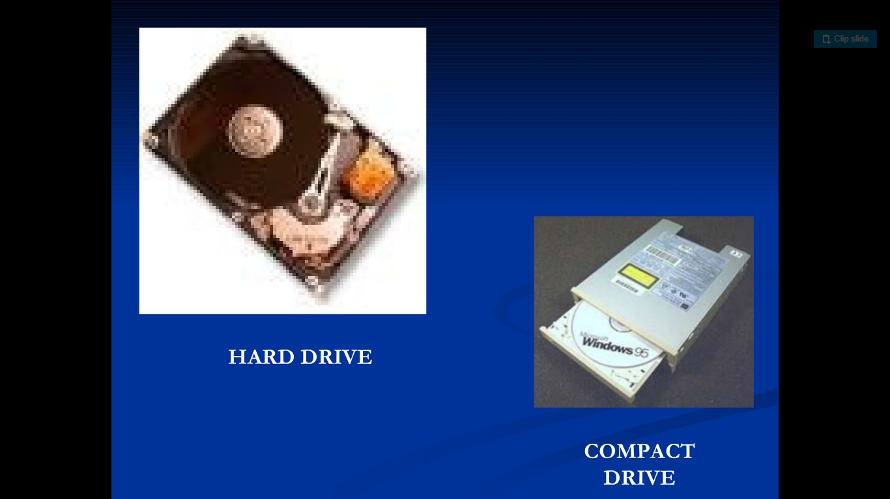
Example
The fact is that many of the courses in computer science deal with efficient algorithm and data structure.
A good understanding of algorithm design is a central to a good understanding of computer science and computer programming.
Asst.Prof Yogesh Somwanshi Fundamental of Algorithm

Slide 18
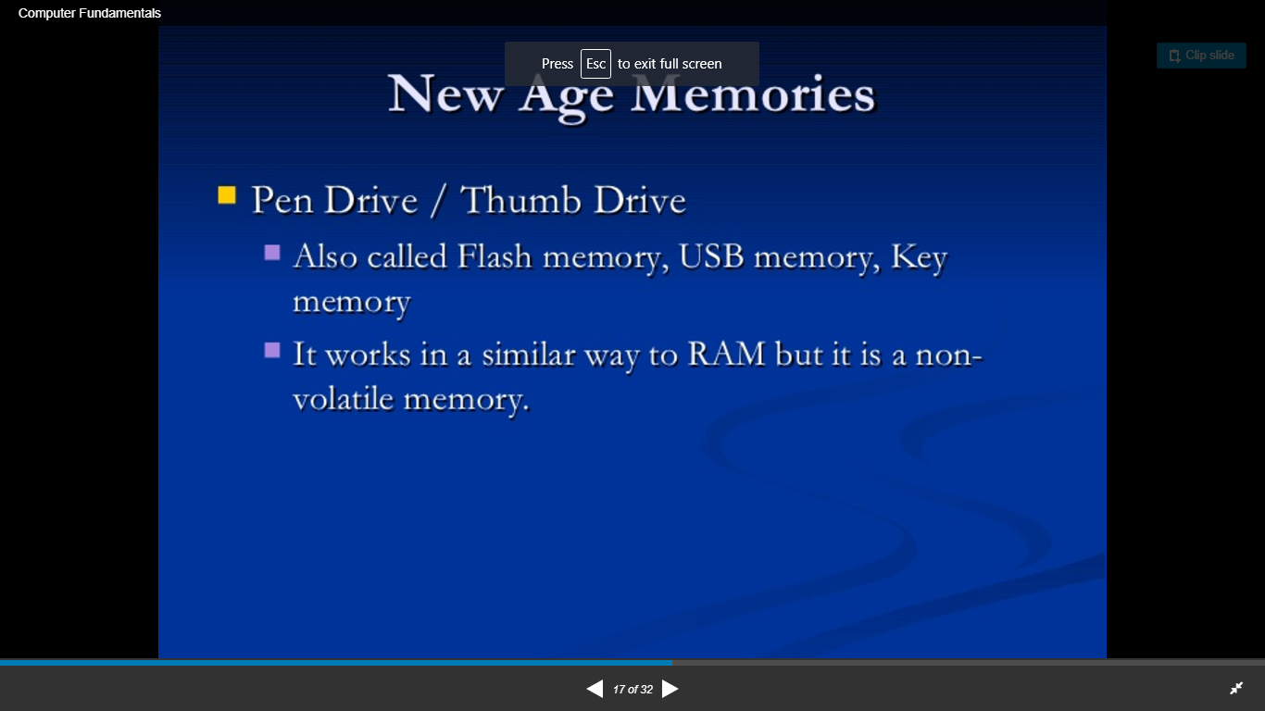
New Type of Memory?
They apply these to various application :
Compilers ,
Operating systems,
Database,
Artificial intelligence,
Computer Graphics and vision,
Networks, etc.
Asst.Prof Yogesh Somwanshi Fundamental of Algorithm

Slide 19
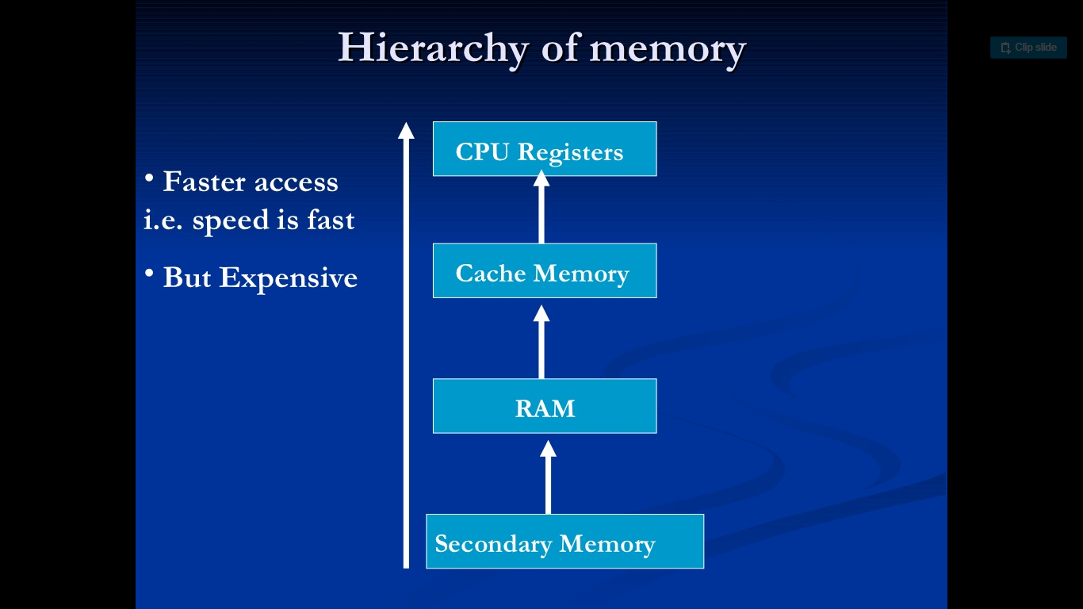
Memory Acess?
Asst.Prof Yogesh Somwanshi Fundamental of Algorithm

Slide 20
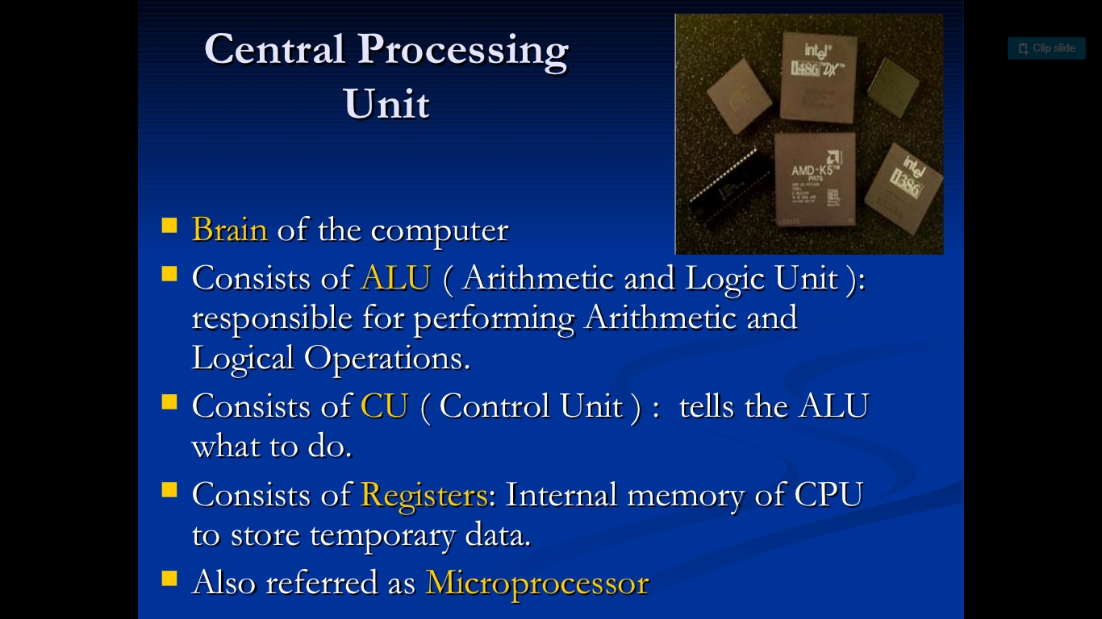
CPU
Asst.Prof Yogesh Somwanshi Fundamental of Algorithm

Slide 21
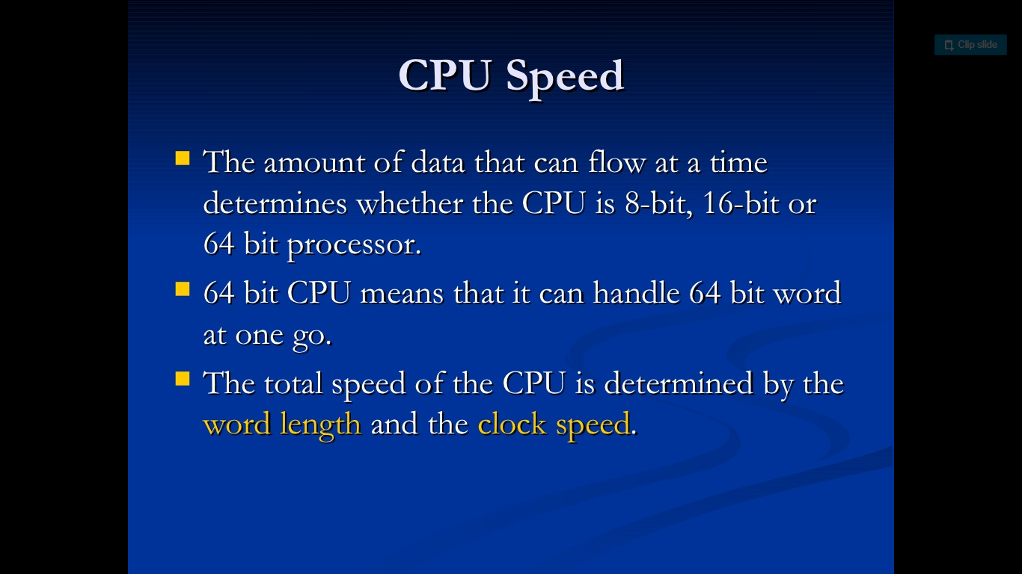
CPU?
Asst.Prof Yogesh Somwanshi Fundamental of Algorithm

Slide 22
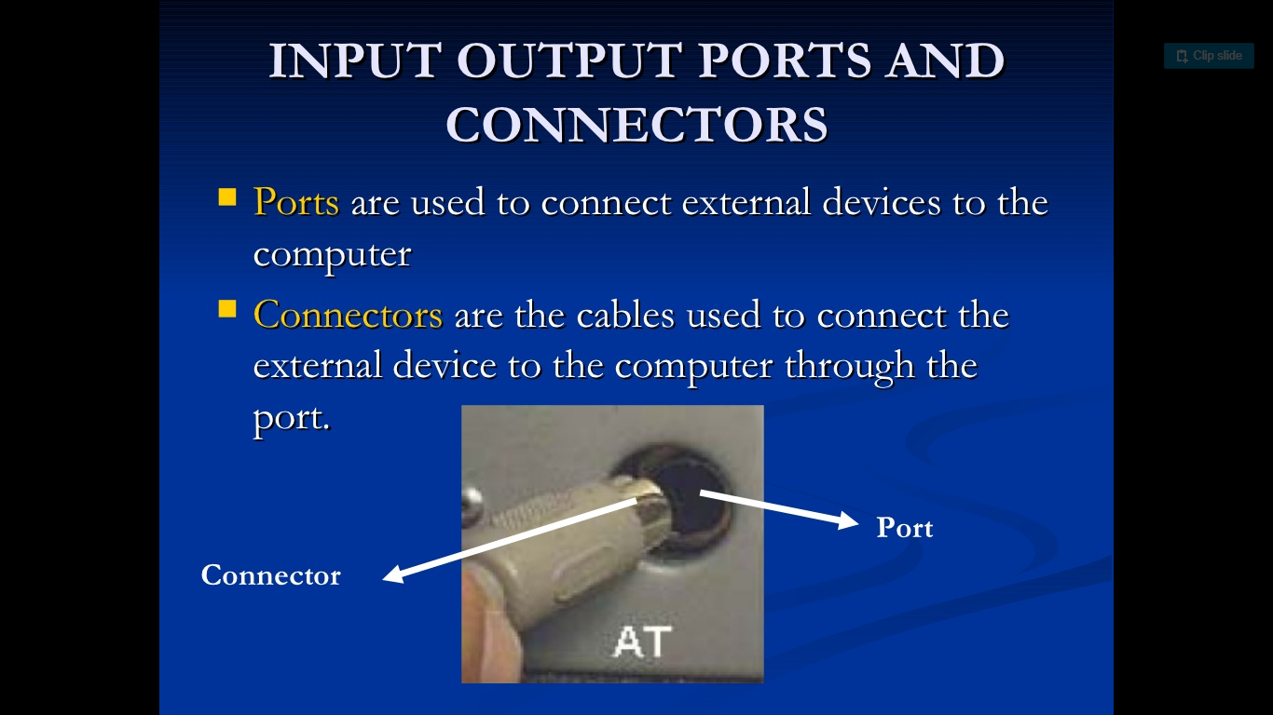
I/O Ports?
Asst.Prof Yogesh Somwanshi Fundamental of Algorithm

Slide 23
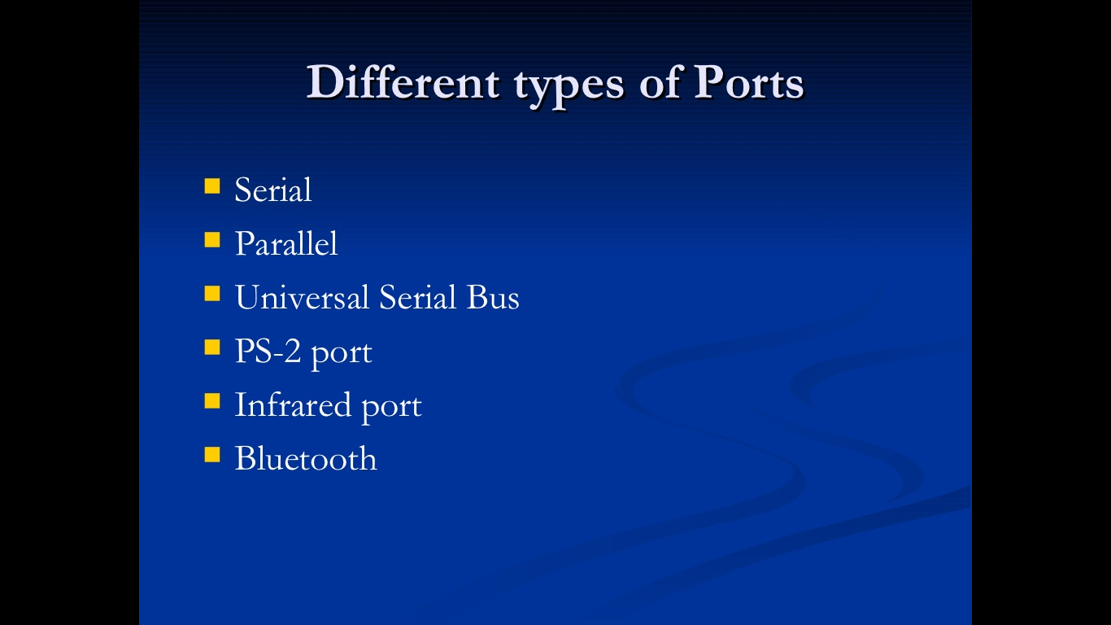
Types of Ports?
Asst.Prof Yogesh Somwanshi Fundamental of Computer

Slide 24
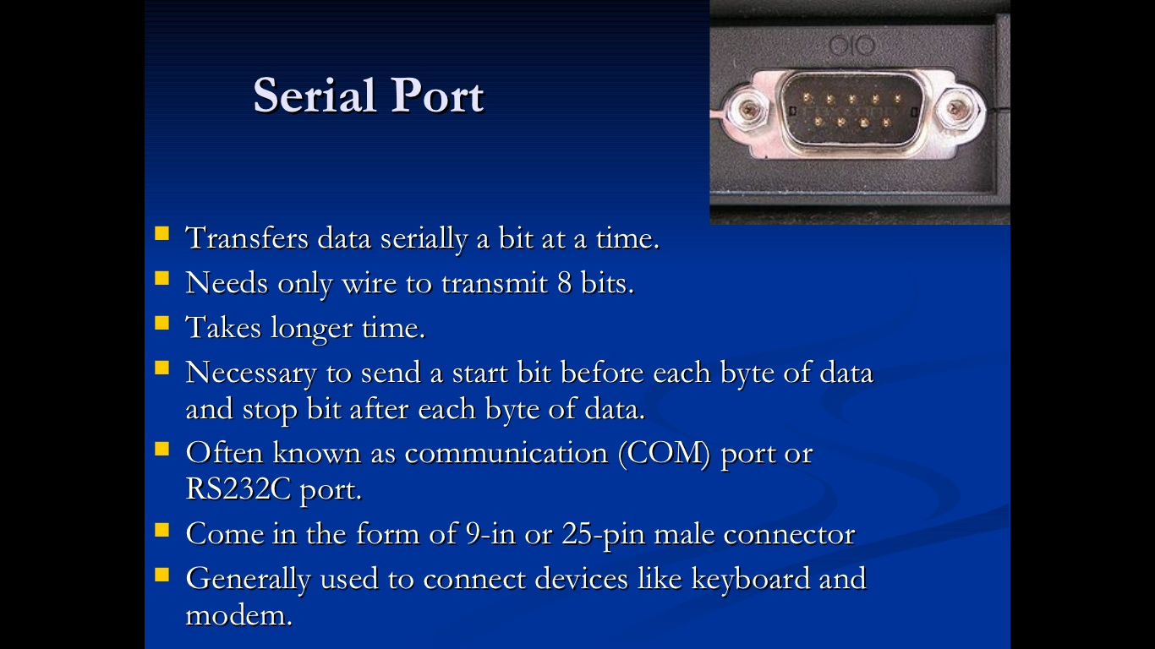
Serial
Asst.Prof Yogesh Somwanshi Fundamental of Computer

Slide 25
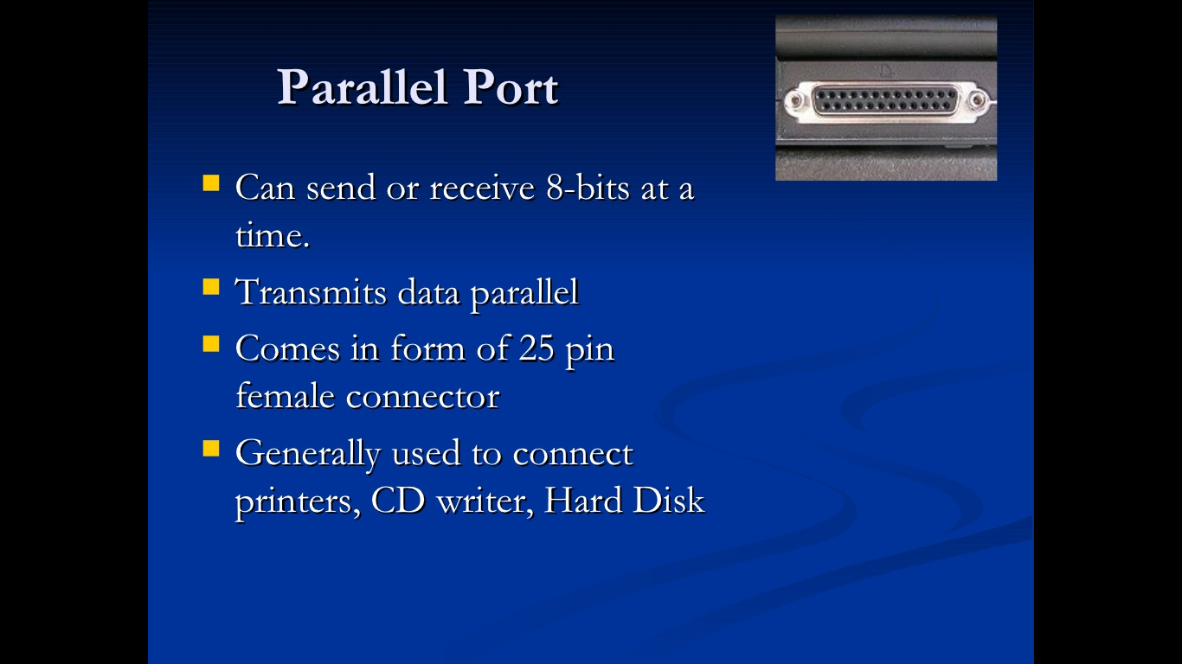
Parallel?
Asst.Prof Yogesh Somwanshi Fundamental of Algorithm

Slide 26
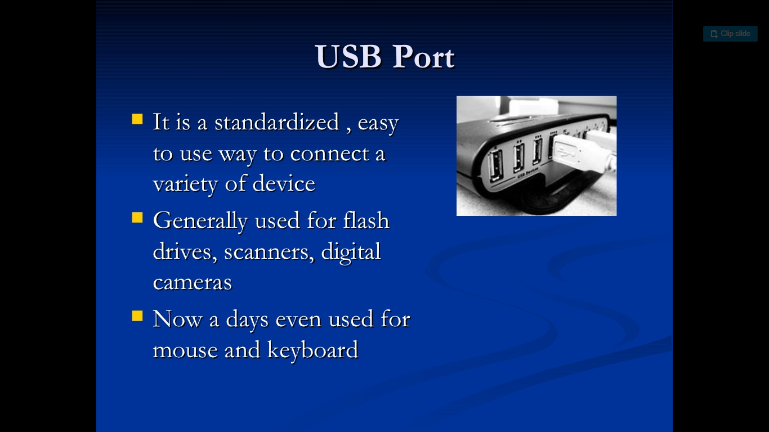
USB?
Asst.Prof Yogesh Somwanshi Fundamental of Computer

Slide 27
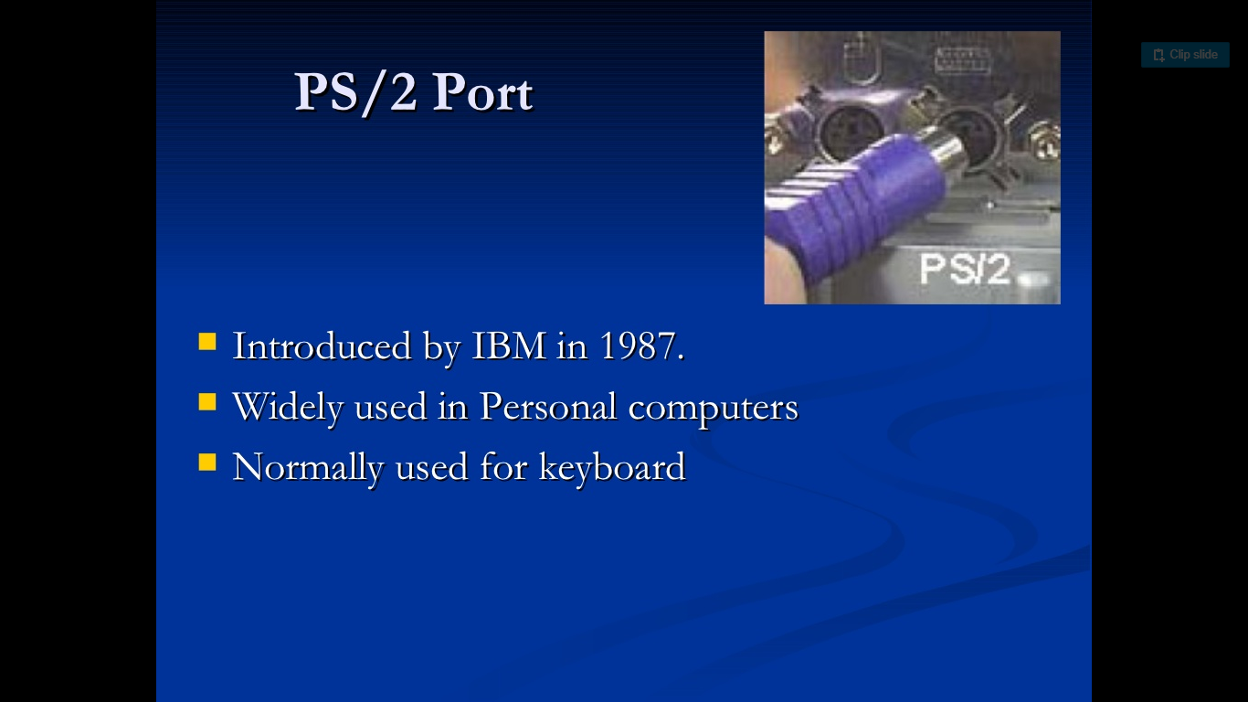
PS/2 ?
Asst.Prof Yogesh Somwanshi Fundamental of Computer

Slide 28
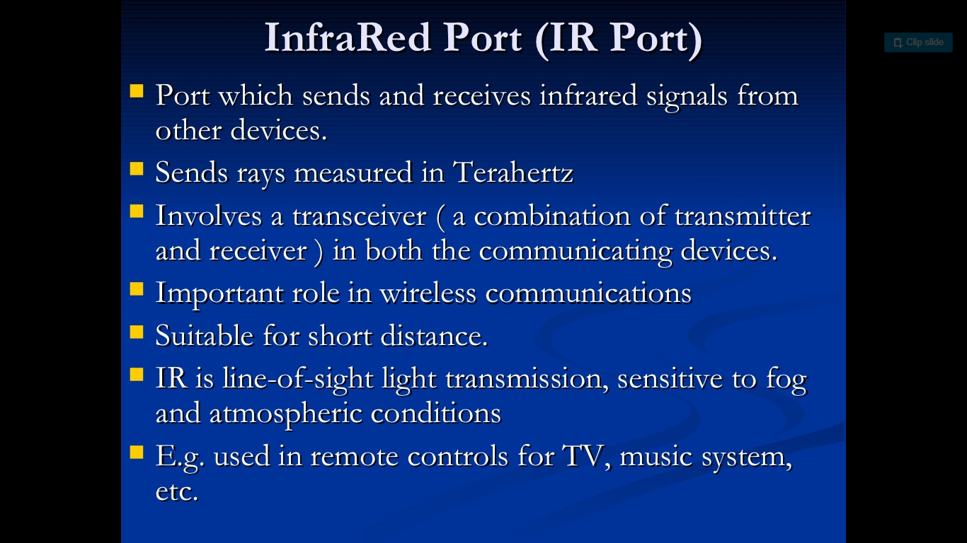
What is Algorithm?
Asst.Prof Yogesh Somwanshi Fundamental of Computer

Slide 29
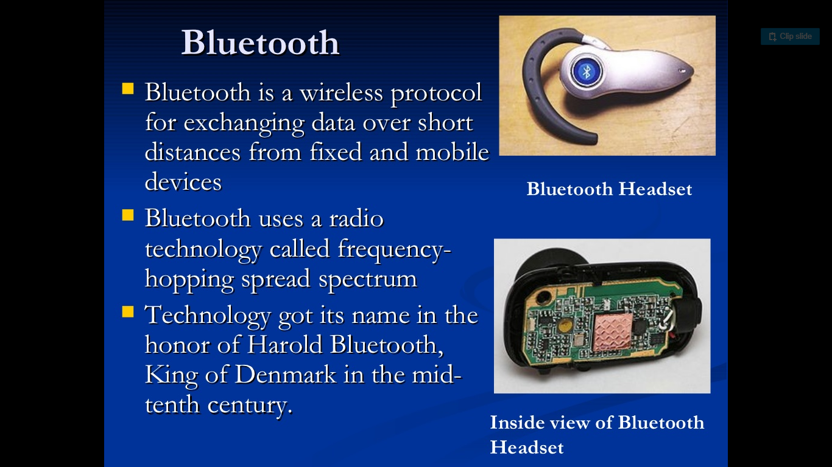
Bluetooth?
Asst.Prof Yogesh Somwanshi Fundamental of Computer

