Slide 1
Mercantile law
Dr Shubhangee L Diwe
Dept of Commerce
Baliram patil college Kinwat

Slide 2
SALE OF GOOD ACT -1930

Slide 3

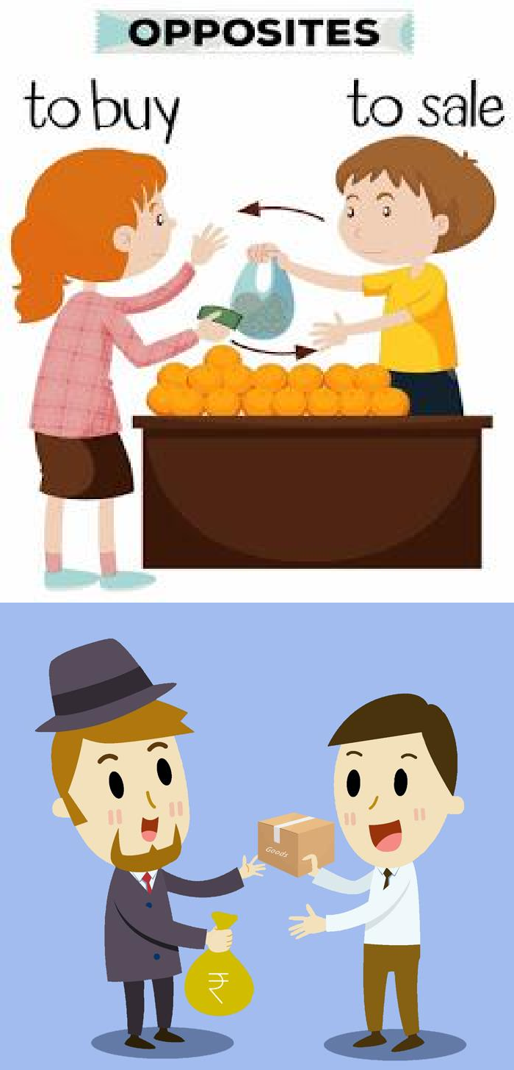

Slide 4
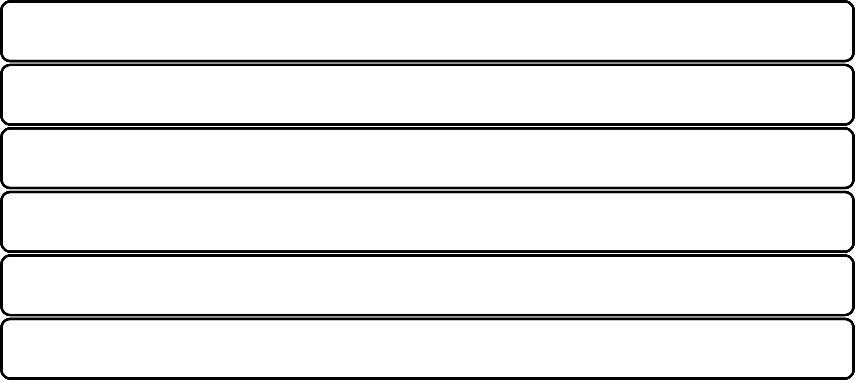
Sale of Goods Act, 1930
The Sale of Goods Act is a kind of Indian Contract Act.
It came into existence on 1 July 1930.
It is a contract whereby the seller transfers or agrees to transfer the title
(ownership) in the goods to the buyer for consideration.
It is applicable all over India, except Jammu and Kashmir.
The goods are sold from owner to buyer for a certain price and at a given period of time.
The act has 66 Sections and VII Chapter.

Slide 5
Sale & Agreement to sell
Section 4 of Sale of Goods Act define the term "Sale" and "agreement to sell" as follows-
As per Section 4 (1): “A contract of sale of goods is a contract whereby the seller transfers or agrees to transfer the property in goods to the buyer for a price. There may be a contract of sale between one part-owner and another.”
As per Section 4 (2), “A contract of sale may be absolute or conditional.”
As per Section 4 (3), “Where under a contract of sale the property in the goods is transferred from the seller to the buyer, the contract is called a sale, but where the transfer of the property in the goods is to take place at a future time or subject to some condition thereafter to be fulfilled, the contract is called an agreement to sell.”
As per Section 4 (a), “An agreement to sell becomes a sale when the time elapses or the conditions are fulfilled subject to which the property in the goods is to be transferred.”

Slide 6
Essential elements of a Contract of Sale:
Two parties: There must be 2 distinct parties i.e. a buyer and a seller, to affect a contract
of sale and they must be competent to contract.
Goods: There must be some goods the property in which is or is to be transferred from the seller to the buyer. The goods which form the subject-matter of the contract of sale must be movable. Transfer of immovable property is not regulated by the Sale of Goods Act.
Price: Price is an essential ingredient for all transactions of sale and in the absence of the price or the consideration, the transfer is not regarded as a sale. The transfer by way of sale must be in exchange for a price.
Transfer of general property: There must be a transfer of general property as
distinguishes from special property in goods from the seller to the buyer.
Essential elements of a valid contract: All essential elements of a valid contract must be
present in the contract of sale.

Slide 7
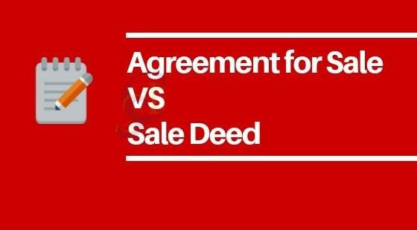

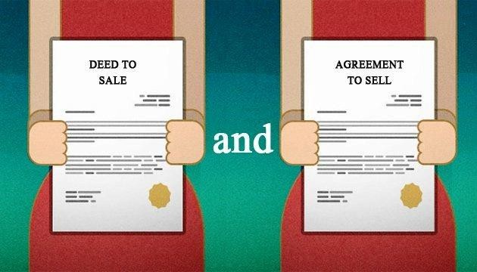

Slide 8
Sale Vs Agreement to Sell
BASIS FOR COMPARISON | SALE | AGREEMENT TO SALE
1. Meaning | When in a contract of sale, the exchange of goods for money consideration takes place immediately, it is known as Sale. | When in a contract of sale the parties to contract agree to exchange the goods for a price at a future specified date is known as an Agreement to Sell.
2. Nature | Absolute | Conditional
3. Type of Contract | Executed Contract | Executory Contract

Slide 9
Sale Vs Agreement to Sell
BASIS FOR COMPARISON | SALE | AGREEMENT TO SALE
4. Transfer of risk | Yes | No
5. Title | In sale, the title of goods transfers to the buyer with the transfer of goods | In an agreement to sell, the title of goods remains with the seller as there is no transfer of goods.
6. Right to sell | Buyer | Seller

Slide 10
SALE Vs AGREEMENT TO SELL
BASIS FOR COMPARISON | SALE | AGREEMENT TO SALE
7. Consequences of subsequent loss or damage to the goods | Responsibility of buyer | Responsibility of seller
8. Tax | GST is charged at the time of sale. | No tax is levied.

Slide 11
Sale Vs Agreement to Sell
BASIS FOR COMPARISON | SALE | AGREEMENT TO SALE
9. Suit for breach of contract by the seller | The buyer can claim damages from the seller and proprietary remedy from the party to whom the goods are sold. | Here the buyer has the right to claim damages only.
10. Right of unpaid seller | Right to sue for the price. | Right to sue for damages.

