Slide 1
Mercantile law
Dr Shubhangee L Diwe
Dept of Commerce
Baliram patil college Kinwat

Slide 2
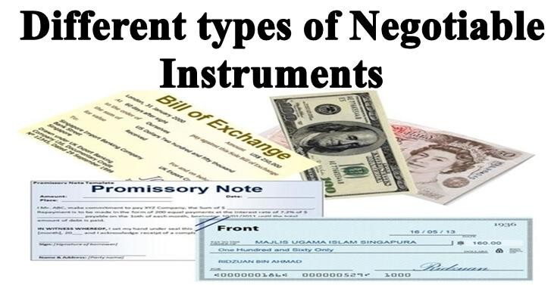

Slide 3
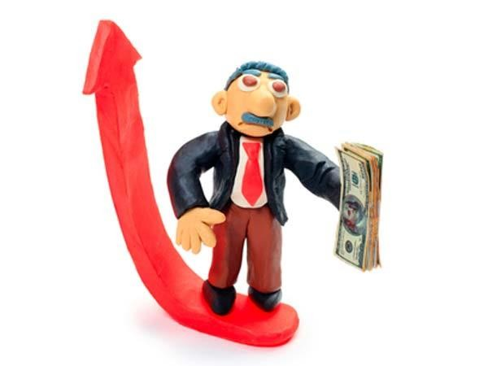
Negotiable Instruments
A negotiable instrument (e.g., a personal check) is a signed document that promises a sum of payment to a specified person or the assignee.
According to Section 13 of the Negotiable Instruments Act, 1881, a negotiable instrument means “promissory note, bill of exchange, or cheque, payable either to order or to bearer”.

Slide 4
Types of Negotiable Instruments
According to the Negotiable Instruments Act, 1881 there are just three types of negotiable instruments i.e., promissory note, bill of exchange and cheque.
However many other documents are also recognized as negotiable instruments on the basis of custom and usage, like hundis, treasury bills, share warrants, etc., provided they possess the features of negotiability.
In the following sections, we shall study about
Promissory Notes (popularly called pronotes)
Bills of Exchange (popularly called bills)
Cheques and Hundis (a popular indigenous document prevalent in India)

Slide 5
1. Promissory Note
Suppose you take a loan of Rupees Five Thousand from your friend Ramesh.
You can make a document stating that you will pay the money to Ramesh or the bearer on demand. Or you can mention in the document that you would like to pay the amount after three months.
This document, once signed by you, duly stamped and handed over to Ramesh, becomes a negotiable instrument.
Now Ramesh can personally present it before you for payment or give this document to some other person to collect money on his behalf.
He can endorse it in somebody else’s name who in turn can endorse it further till
the final payment is made by you to whosoever presents it before you.
This type of a document is called a Promissory Note.

Slide 6
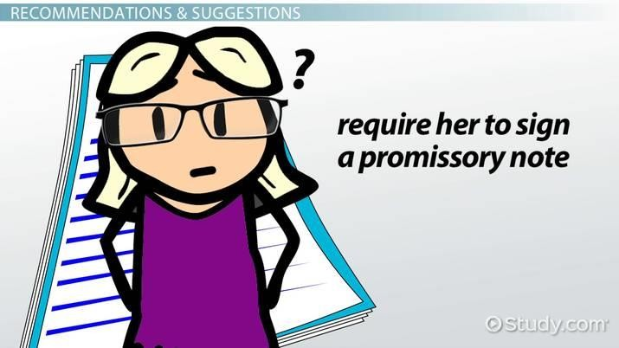
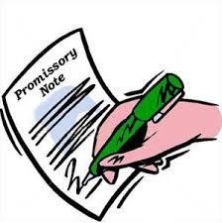
Promissory Note
Section 4 of the Negotiable Instruments Act, 1881 defines a promissory note as ‘an instrument in writing (not being a bank note or a currency note) containing an unconditional undertaking, signed by the maker, to pay a certain sum of money only to or to the order of a certain person or to the bearer of the instrument’

Slide 7
Specimen of a Promissory Note
New Delhi September 25,2002
Rs. 10,000/-
On demand, I promise to pay Ramesh, s/o RamLal of Meerut or order a sum of Rs 10,000/- (Rupees Ten Thousand only), for value received.
To , Ramesh Address……..
Sd/ Sanjeev Stamp

Slide 8
Parties to a Promissory Note
There are primarily two parties involved in a promissory note. They are-
The Maker or Drawer – the person who makes the note and promises to pay the amount stated therein. In the above specimen, Sanjeev is the maker or drawer.
The Payee – the person to whom the amount is payable. In the above specimen it is Ramesh.
In course of transfer of a promissory note by payee and others, the parties involved may be –
The Endorser – the person who endorses the note in favour of another person. In the above specimen if Ramesh endorses it in favour of Ranjan and Ranjan also endorses it in favor of Puneet, then Ramesh and Ranjan both are endorsers.
The Endorsee – the person in whose favour the note is negotiated by endorsement. In the above, it is Ranjan and then Puneet.

Slide 9

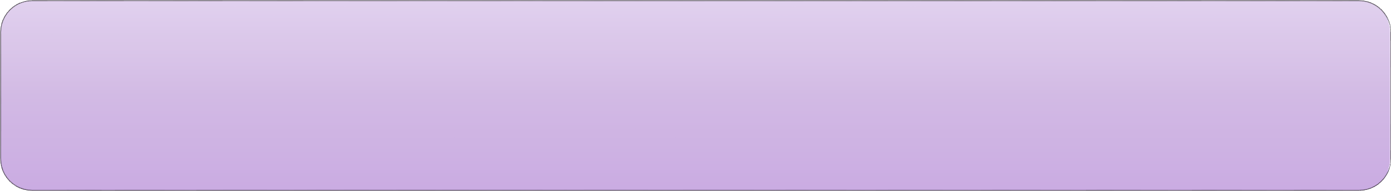

Features of a promissory note
A promissory note must be in writing, duly signed by its maker and properly stamped as per Indian Stamp Act.
It must contain an undertaking or promise to pay. Mere acknowledgement of indebtedness is not enough. For example, if some one writes ‘I owe Rs. 5000/- to Satya Prakash’, it is not a promissory note.
The promise to pay must not be conditional. For example, if it is written ‘I promise to pay Suresh Rs 5,000/- after my sister’s marriage’, is not a promissory note.

Slide 10

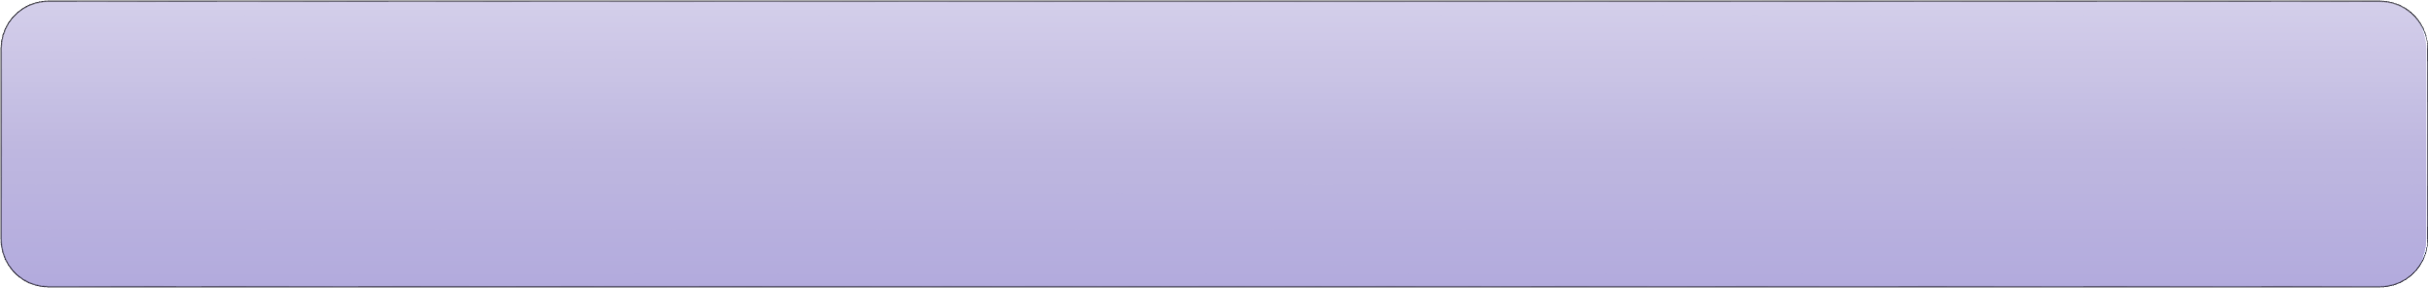


Features of a promissory note
It must contain a promise to pay money only. For example, if some one writes ‘I promise to give Suresh a Maruti car’ it is not a promissory note.
The parties to a promissory note, i.e. the maker and the payee must be certain.
A promissory note may be payable on demand or after a certain date. For example, if it is written ‘three months after date I promise to pay Satinder or order a sum of rupees Five Thousand only’ it is a promissory note.
Vii. The sum payable mentioned must be certain or capable of being made certain. It means that the sum payable may be in figures or may be such that it can be calculated

Slide 11
2. Bill of Exchange
Suppose Rajiv has given a loan of Rupees Ten Thousand to Sameer, which
Sameer has to return.
Now, Rajiv also has to give some money to Tarun. In this case, Rajiv can make a document directing Sameer to make payment up to Rupees Ten Thousand to Tarun on demand or after expiry of a specified period.
This document is called a Bill of Exchange, which can be transferred to some other person’s name by Tarun.
Section 5 of the Negotiable Instruments Act, 1881 defines a bill of exchange as ‘an instrument in writing containing an unconditional order, signed by the maker, directing a certain person to pay a certain sum of money only to or to the order of a certain person, or to the bearer of the instrument’.

Slide 12
Specimen of a Bill of Exchange
Rs. 10,000/-
New Delhi May 2, 2001
Fivemonths after date pay Tarun or (tohis) orderthe sum of Rupees Ten Thousand only for value received.

Slide 13
Parties to a Bill of Exchange
There are three parties involved in a bill of exchange. They are-
The Drawer – The person who makes the order for making payment. In the above specimen, Rajiv is the drawer.
The Drawee – The person to whom the order to pay is made.He is generally a debtor of the drawer. It is Sameer in this case.
The Payee – The person to whom the payment is to be made. In this case it is Tarun.
Note: The drawer can also draw a bill in his own name thereby he himself becomes the payee. Here the words in the bill would be Pay to us or order. In a bill where a time period is mentioned, just like the above specimen, is called a Time Bill. But a bill may be made payable on demand also. This is called a Demand Bill.

Slide 14






Features of a bill of exchange
i. A bill must be in writing, duly signed by its drawer, accepted
by its drawee and properly stamped as per Indian Stamp Act.
ii. It must contain an order to pay. Words like ‘please pay Rs 5,000/- on demand and oblige’ are not
used.
iii. The order must be unconditional.
v. The sum payable mentioned must be certain or capable of being made certain.
iv. The order must be to pay money and
money alone.
vi. The parties to a bill must be certain

Slide 15
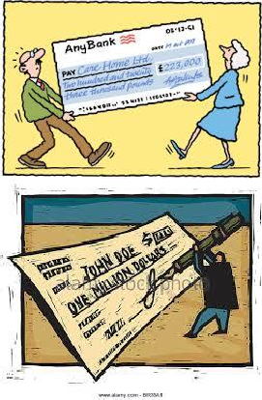
3. Cheques
Cheque is a very common form of negotiable instrument. If you have a savings bank account or current account in a bank, you can issue a cheque in your own name or in favor of others, thereby directing the bank to pay the specified amount to the person named in the cheque.
Therefore, a cheque may be regarded as a bill of exchange; the only difference is that the bank is always the drawee in case of a cheque.
The Negotiable Instruments Act, 1881 defines a cheque as a bill of exchange drawn on a specified banker and not expressed to be payable otherwise than on demand.
Actually, a cheque is an order by the account holder of the bank directing his banker to pay on demand, the specified amount, to or to the order of the person named therein or to the bearer.

Slide 16
Specimen of a Cheque
………......20....... Pay……..............................................................................................................
……....................................................................................................... or Bearer
Rupees………………………………………………
Rs.
Rs. _________
……………………………………………………
STATE BANK OF INDIA
Jawaharlal Nehru University, New Delhi – 110067 MSBL/97
6 5 3 0 0 3 1 1 0 0 0 2 0 5 6
1 0

Slide 17
Features of a cheque
A cheque must be in writing and duly signed by the drawer.
It contains an unconditional order.
It is issued on a specified banker only.
The amount specified is always certain and must be clearly mentioned both in figures and words.
The payee is always certain.
It is always payable on demand.
The cheque must bear a date otherwise it is invalid and shall not be honoured by the bank

Slide 18
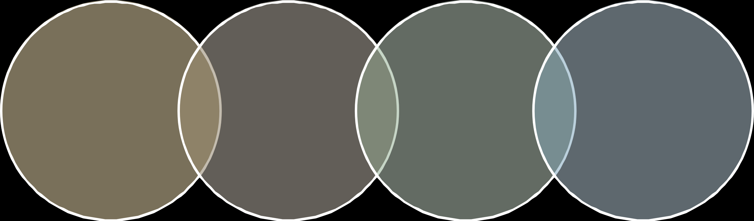
Types of Cheque
b) Crossed cheque
a) Open cheque
c) Bearer cheque
d) Order cheque

Slide 19
Types of Cheque
Open cheque: A cheque is called ‘Open’ when it is possible to get cash over the counter at the bank. The holder of an open cheque can do the following:
Receive its payment over the counter at the bank,
Deposit the cheque in his own account
Pass it to some one else by signing on the back of a cheque.
Crossed cheque: Since open cheque is subject to risk of theft, it is dangerous to issue such cheques. This risk can be avoided by issuing
another types of cheque called ‘Crossed cheque’. The payment of such
cheque is not made over the counter at the bank. It is only credited to the bank account of the payee. A cheque can be crossed by drawing two transverse parallel lines across the cheque, with or without the writing ‘Account payee’ or ‘Not Negotiable’.

Slide 20
Types of Cheque
Bearer cheque: A cheque which is payable to any person who presents it for payment at the bank counter is called ‘Bearer
cheque’. A bearer cheque can be transferred by mere delivery and requires no endorsement.
Order cheque: An order cheque is one which is payable to a
particular person. In such a cheque the word ‘bearer’ may be cut out or cancelled and the word ‘order’ may be written. The payee can transfer an order cheque to someone else by signing his or her name on the back of it.

Slide 21

Hundis
A Hundi is a negotiable instrument by usage.
It is often in the form of a bill of exchange drawn in any local language in accordance with the custom of the place.
Some times it can also be in the form of a promissory note. A hundi is the oldest known instrument used for the purpose of transfer of money without its actual physical movement.
The provisions of the Negotiable Instruments Act shall apply to hundis only
when there is no customary rule known to the people.

Slide 22
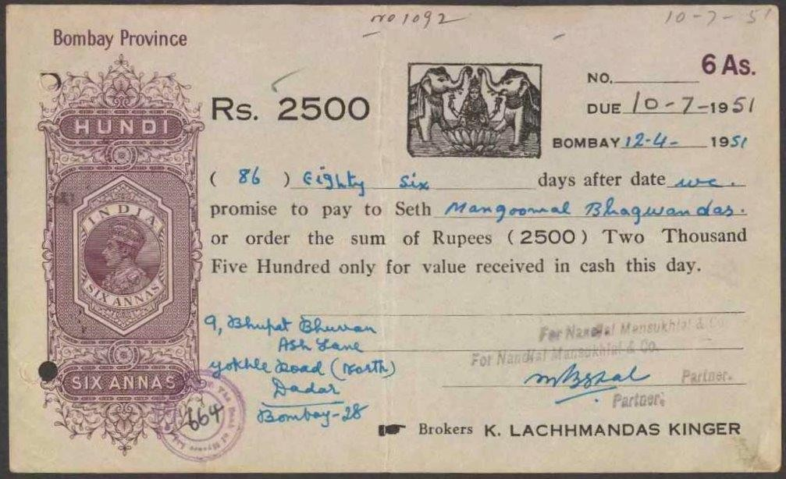
Hundi

Slide 23

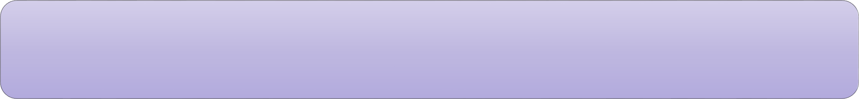


Types of Hundis
Shah-jog Hundi: This is drawn by one merchant on another, asking the latter to pay the amount to a Shah. Shah is a respectable and responsible person, a man of worth and known in the bazaar. A shah-jog hundi passes from one hand to another till it reaches a Shah, who, after reasonable enquiries, presents it to the drawee for acceptance of the payment.
Darshani Hundi: This is a hundi payable at sight. It must be presented for payment within a reasonable time after its receipt by the holder. Thus, it is similar to a demand bill.
Muddati Hundi: A muddati or miadi hundi is payable after a specified period of time. This is similar to a time bill.
There are few other varieties like Nam-jog hundi, Dhani-jog hundi, Jawabee hundi, Jokhami hundi, Firman-jog hundi, etc.

Slide 24
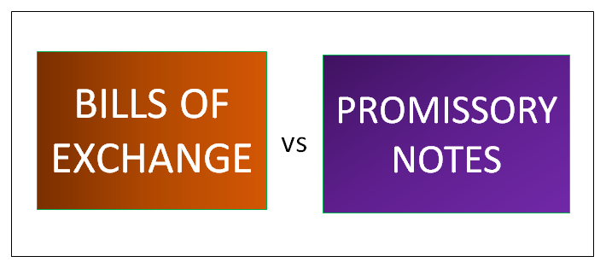

Slide 25
Distinction between a Promissory Note and a Bill of Exchange
 | Bills of Exchange | Promissory Notes
1. Meaning | Bills of exchange are negotiable instruments which demand money from debtors within a stipulated period of time. | Promissory notes are also negotiable instruments which promise to pay a certain amount within a particular period of time.
2. What it’s all about? | Ordering to pay the money that is due. | Promising to pay the money that is due.
3. Issued by | Creditors. | Debtors
4. Acceptance | Bills of exchange need to be accepted by the debtors to be called as valid. | There’s no such norm.

Slide 26
Distinction between a Promissory Note and a Bill of Exchange
 | Bills of Exchange | Promissory Notes
5. Parties involved | There are three parties involved – drawer, drawee, and payee. | Here, two parties are involved – drawer and payee.
6. Application of copies | Bills of exchange can be drawn in copies. | Promissory notes can’t be drawn in copies.
7. In case of dishonour | When the bill is dishonoured, a notice is given to all parties that are involved. | When a promissory note is dishonoured, notice is not issued to the maker (debtor).

Slide 27
THANK YOU

