Slide 1
INSOLVENCY ACCOUNTS
Dr. shubhangee L. Diwe
Department of commerce
Baliram patil college ,kinwat

Slide 2
Insolvency account
Insolvency Accounts Insolvency is a financial stringency i.e. when an individual or an organization/company is no longer capable to pay the debts he/it owes. Insolvency usually leads to insolvency proceedings, in which legal action can be taken against the insolvent, and assets may be liquidated to pay off the outstanding debts.

Slide 3
Insolvency Accounts Definition
What are insolvency accounts?
Insolvency Accounts: Adjudication, Procedure and Statement of Affairs! A person is commonly said to be insolvent if he is unable to meet his liabilities as and when claimed. That is, when a person becomes heavily indebted due to various circumstances and it be­comes impossible for him to pay his debts fully.
.

Slide 4
Act of insolvency
Act of insolvency means, when a person (debtor) shows that he is not able to pay his liabilities.
An order of adjudication must be passed by the court of law, before legally declaring any person insolvent. To pass an order of adjudication by the court of law, a petition should be filed by any of the creditor or creditors or by the debtor himself.

Slide 5
The Order of Discharge
Order of discharge is an order issued by the court of law to the insolvent. Normally, this order releases the insolvent from all current and provable debts and liberates him from the legal obligations imposed on as insolvent. The order of discharge is issued on the basis of the report submitted by the official receiver and on the application of the insolvent.
Interest
An interest @ 6% pa will be paid to the creditors for the period, after the order of adjudication, if, any surplus remains, after full payment to the creditors.

Slide 6
Voluntary Transfer
As per the Presidency Towns Insolvency Act, any property transferred by the insolvent without any consideration during the two years preceding the order of adjudication shall be void. Under the Provincial Insolvency Act, such transfer became inoperative, if made with two years of petition of the insolvency except followings −
For consideration of marriage and made before and
To purchase valuable consideration in good faith.

Slide 7
Insolvency Law
The Insolvency Act in India is based on English Bankruptcy Act and following two acts are applicable on the Indian Territory −
The Presidency Towns Insolvency Act, 1909 − Applicable to Mumbai, Kolkata, and Chennai.
The Provisional Insolvency Act, 1920 − Applicable to the rest of India except Mumbai, Kolkata, and Chennai.
Above Insolvency Acts are applicable to any Individual, Partnership Firm, and Hindu Undivided Family only. Companies Act, 1956 applies to Joint stock companies and the term liquidation is used instead of Insolvency. In case of insolvency, a person is not able to pay his liabilities but in case of liquidation, company may be liquidated even it has the sufficient amount to pay its liabilities.

Slide 8
Insolvency Accounts
Under the Presidency Towns Insolvency Act, insolvent has to submit following documents to the court of law −
Statement of Affairs as on date of order and
Deficiency Account.

Slide 9
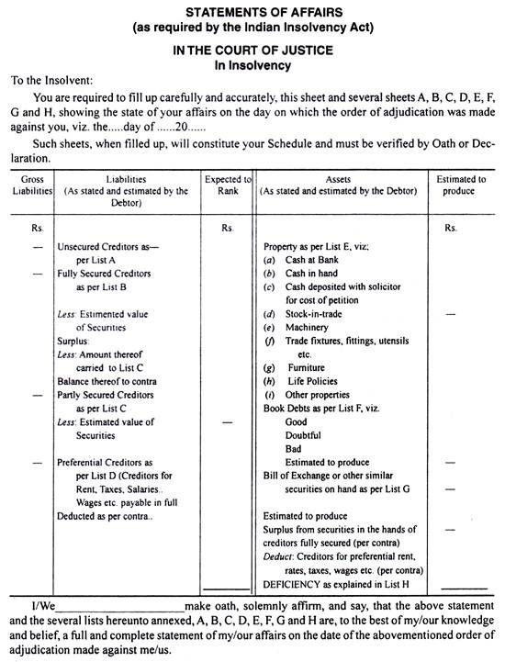

Slide 10
The explana­tion of each List is given below:
1. List A-Unsecured Creditors as per List A:
This list includes all Creditors, who do not possess any security of the Insolvent Debtor. That is, the Creditors without security fall under this list.
Some of such Creditors are:
Trade Creditors without security
Loan Creditors without security
Bank Overdraft unsecured
Bills Payable and Promissory Notes
Bills Receivable discounted likely to be dishonoured
Salary, Wages, Rent etc. over Preferential limit.

Slide 11
List B-Fully Secured Creditors:
This list includes all the Creditors, who have a claim against the debtor and have obtained a lien, guarantee or possession of some deeds or other securities. That is, the creditors, who have sufficient securities of the insolvent Debtor to meet their claims. The value of the securities may be equal to or more than the amount of their claims.

Slide 12
List C-Partly Secured Creditors:
There are certain Creditors, who have the security for a lesser value than the amount of their claims. That is, the Creditors of this type got only partial security for the loan advanced by them.
The securi­ties are insufficient to meet the claims. For instance, a loan of Rs 10,000 has been taken and the security for this loan is only Rs. 6,000. So, the loan is partly secured. The value of the security is not sufficient to cover their claims fully. The excess of loan over the security is shown in the outer col­umn.

Slide 13
. List D-Preferential Creditors:
This list shows the Preferential Creditors, who are entitled to priority over other debts of the insol­vent. For instance, taxes, rates, wages, salaries etc. are paid in full.

Slide 14
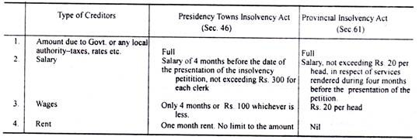
The following is the details of Preferential Creditors under the Presidency Towns Insolvency Act and Provincial Insolvency Act:

Slide 15
The following are the lists shown in the asset side of the Statement of Affairs:
List E-Properties:
This is a list which includes all the assets of the Insolvent, except Book Debts, Bills Receivable and assets which have not been given as security to Creditors. Here all the assets-unencumbered properties i.e., free assets are shown. For instance, Cash in hand, Cash at Bank, Furniture, Machinery etc. Both book value and realisation value are shown.

Slide 16
List F-Book Debts:
All the debtors of the insolvent are shown in this list. Good, Doubtful and Bad debts are shown separately.
7. List G—Bills of Exchange etc.:
This list contains the information about Bills Receivable and Promissory Notes. The book value and the realizable value are shown separately.
8. List H-Deficiency Account:
This list shows the deficiency i.e., liabilities of the Debtors over realizable value of his assets. For this purpose a separate Deficiency Account is prepared. (This is explained separately.) Now, after writing the Lists E, F and G, the surplus, as per List B, appears on the liability side, is added to the assets. From this amount, the Preferential Creditors as per List D are deducted. The balance, so arrived, is the amount of assets available for distribution among the Creditors.

Slide 17
Deficiency Account:
Deficiency Account:
In addition to various lists- Lists A to List G-the Debtor has to prepare a Deficiency Account which explains as to how the deficiency shown in the Statement of Affairs has arisen. The insolvent debtor is required to account for the loss to the amount of his capital and of his Creditors.

Slide 18
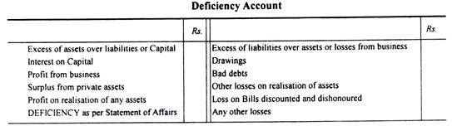
Deficiency Account Profoma

Slide 19
Priority of Payments:
The Official Assignee or Receiver realizes the assets and distributes the proceeds in the following order of priority:
1. Fully secured creditors, in full
2. Partly secured creditors to the extent they are secured
3. Expenses of realisation and remuneration to the receiver
4. Preferential creditors
5. Unsecured creditors, including uncovered balance of partly secured creditors.
Interest:
A creditor is not allowed to claim interest after the date of insolvency. However, if all the claims have been satisfied in full, then till the date of payment, interest @ 6% is allowed.
Loan from Wife:
If the wife has given the loan to her husband out of her personal property or dowry or self-earned income, then the amount of loan is included in Creditors. But if the wife’s loan is out of the money given to her by her husband, then the loan is taken as the capital of Insolvent, that is, such amount is not included in the creditors list.

Slide 20
PACKAGE ACCOUNT
Since packages are essential for the products, cost of the packages will be included in the selling price of the commodity. Under such circumstances, containers or pack­ages stock account is opened. This Packages or Containers Stock Account is debited with the Open­ing Stock and Purchases and Credit with the Closing Stock.

Slide 21
NEED OF PACKAGE
Every businessman wants to maximize his profits. For this, he wants to increase his sales. Various facilities are provided to the customers. Packages or containers play an important role in increasing sales.
Goods are very often packed into bottles, boxes, bags, cans, drums, etc. for the purpose of preserving, transporting and marketing. These packing materials, which are called packages, contain­ers or empties, are durable as well, as reusable
The goods are packed by the suppliers for safe delivery at the destination of the customers and also with the object of putting the goods in a saleable condition. Packages or containers may either be manufactured by the concern itself or bought from outside.
In either the case, they involve expenditure which must be recovered from the sale price of the articles packed. Therefore, there is the need for accounting of packages or containers. The accounting procedure for containers largely depends upon the way in which they are handled.

Slide 22


