Slide 1
ACCOUNTS OF ELECTRICITY COMPANY
Dr. shubhangee L. Diwe
Department of commerce
Baliram patil college ,kinwat

Slide 2
DEFINATION OF ELECTRICITY COMPANY
The electricity companies means generation (manufacturing) of electricity, transmission of electricity, distribution of electricity and trading of electricity.

Slide 3
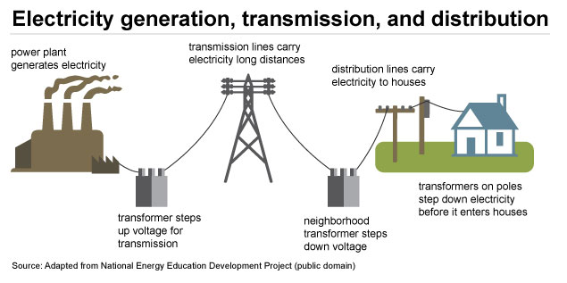
ELECTRICITY COMPANY

Slide 4
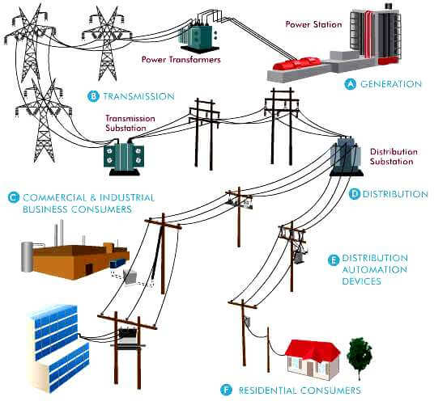
ELECTRICITY SUPPLY

Slide 5
Double account system
The double account system is method of presenting the annual final accounts .every electricity supply company is required to submit to the state government of nominee. The electricity (supply) Act 1948 came into force on10 th sept 1948 .
Every electricity company must submit their annual accounts as per prescribed format within 6 months from the date of year end.

Slide 6
The final accounts of electricity company consist of(under the ‘Double Account system’)
1) Revenue Account
2) Net Revenue Account
3) Capital account
4) General Balance Sheet

Slide 7
Revenue account
Revenue Account This account is similar to the Profit and Loss Account of a trading or manufacturing concern. It is debited with various items of expenses and credited with various items of incomes. Depreciation on fixed assets is charged by debiting the Revenue Account and crediting the Depreciation Fund Account.

Slide 8
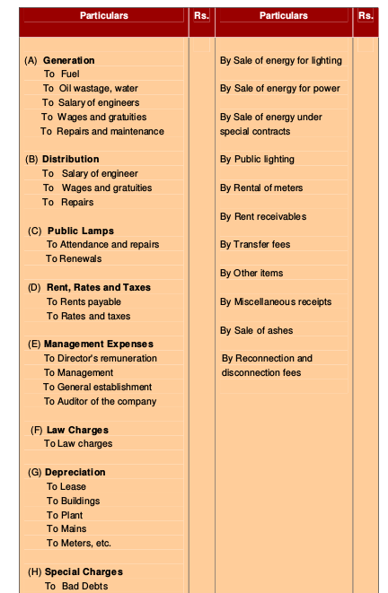

Slide 9
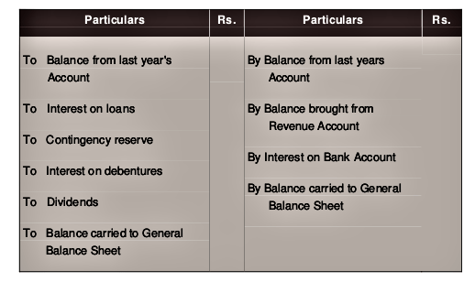
Net Revenue account This is similar to the profit and loss appropriation account of trading and manufacturing concerns except the treatment of interest on loan and debentures.

Slide 10
CAPITAL ACCOUNT
Capital Account (Receipts and Expenditure on Capital Account) The main purpose of this account is to show total amount of capital raised and its application for acquisition of fixed assets for carrying on the business. As per the statutory forms (prescribed by the Indian Electricity Act, 1910) there are three columns on each side:

Slide 11
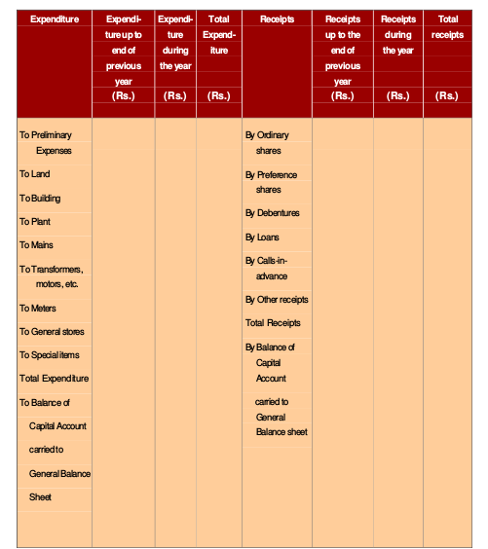

Slide 12
GENERAL BALANCE SHEET
In the General Balance Sheet, all the remaining assets and liabilities, like current assets, current liabilities, reserves, etc., are shown along with the total of receipts (on the liability side) and the total expenditure (on the asset side). The Statutory Form of General Balance Sheet under Indian Electricity Act, 1910 is given below:

Slide 13
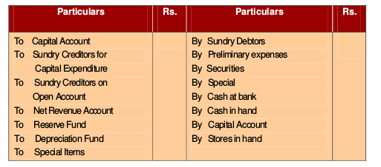
GENERAL BALANCE SHEET

Slide 14
The students should note the following important matters which will affect the accounts of electricity companies as provided in the Sixth Schedule to The Electricity (Supply) Act. 1948. These are as follows: (a) Depreciation on fixed assets (b) Fixed assets and their prescribed life (c) Contingency reserve (d) Development reserve (e) General reserve (f) Appropriation of profits

Slide 15
Contingencies Reserve Every electricity supply company is required to maintain a Contingencies Reserve. A sum equal to not less than 1/4% or not more than 1/2% of the original cost of fixed assets must be transferred from the Revenue Account to the Contingencies Reserve. The maximum amount in this account must not exceed 5% of the original cost of the fixed assets. The amount of Contingencies Reserve must be invested in trust securities.With the prior approval of the State Government, the Contingencies Reserve can be utilised for the following purposes : ( i ) For meeting expenses or loss of profit due to accident, strikes or circumstances beyond the control of the management; (ii) For meeting expenses on replacement or removal of plant or works other than expenses required for normal maintenance or renewals; (iii) For paying compensation under any law for the time being in force and for which no other provision has been made.

